Slide 1
R in Academic Finance (From Theory to Practice)
Sanjiv R. Das
Professor, Santa Clara University
Department of Finance
http://algo.scu.edu/~sanjivdas/
R Finance Conference
Chicago May 2013

Slide 2
Outline
General Principles.
Performance computing for Finance. To start: Using R in parallel, and with C (also with Python).
Identifying systemically risky financial institutions using R network models.
Modeling the optimal modification of home loans using R
Goal-based portfolio optimization with R
Identifying venture capital communities with R
Using R to deliver functions/models on the web, and for pedagogical purposes.

Slide 3
THEORY
MODELS
INTUITION
“He convincingly establishes the difference between model and theory and shows why attempts to model financial markets can never be genuinely scientific. It vindicates those of us who hold that financial modeling is neither practical nor scientific. Exceedingly readable.” —Nassim N. Taleb, author of The Black Swan

Slide 4
General Principles
No theory, no paper.
Inference Stack:
Theory
Causation
Prediction
Correlation
Computational Theory (e.g. sets in R)
Small data
Big data

Slide 5
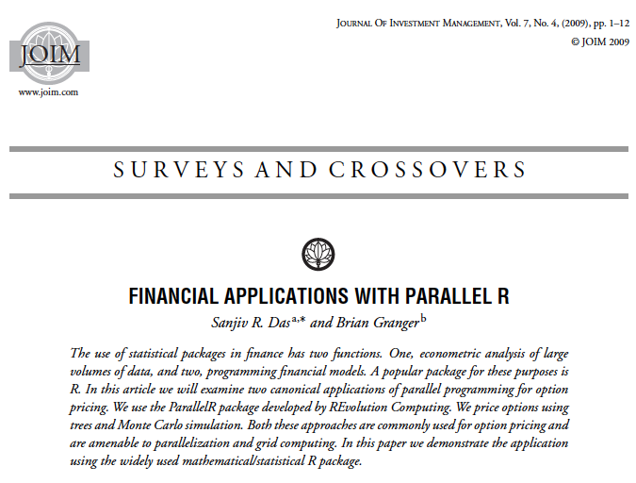
Finance is replete with embarrasingly parallel problems.

Slide 6
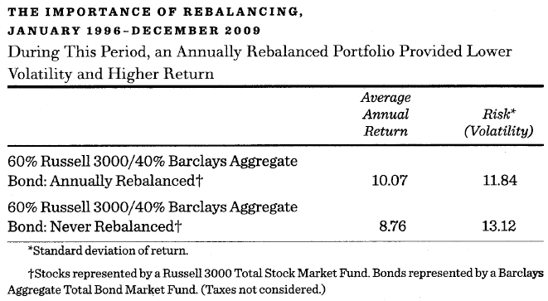
Calling C from R: An Example of Tax-optimized Portfolio Rebalancing

Slide 7
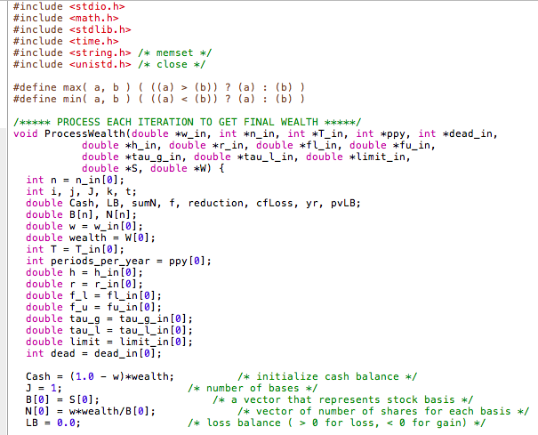
Calling C from R: An Example of Tax-optimized Portfolio Rebalancing

Slide 8
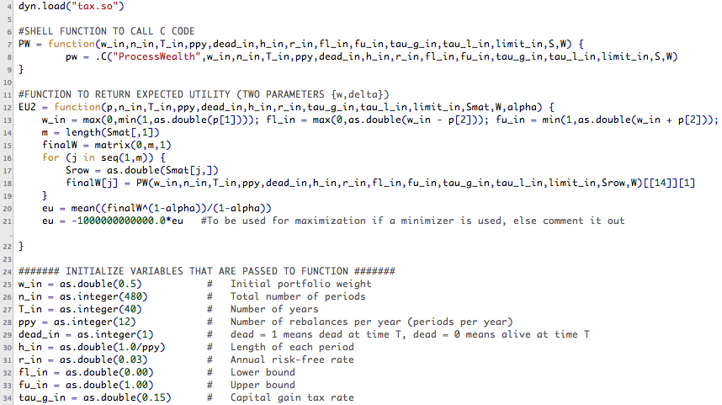
R CMD SHLIB tax.c

Slide 9
Comparative Statics

Slide 10
Managing Systemic Risk by analyzing networks using R (and other tools) The MIDAS Project @IBM
Paper: “Unleashing the Power of Public Data for Financial Risk Measurement, Regulation, and Governance” (with Mauricio A. Hernandez, Howard Ho, Georgia Koutrika, Rajasekar Krishnamurthy, Lucian Popa, Ioana R. Stanoi, Shivakumar Vaithyanathan) IBM Almaden) [IEEE Data Engineering Bulletin 2011]

Slide 11
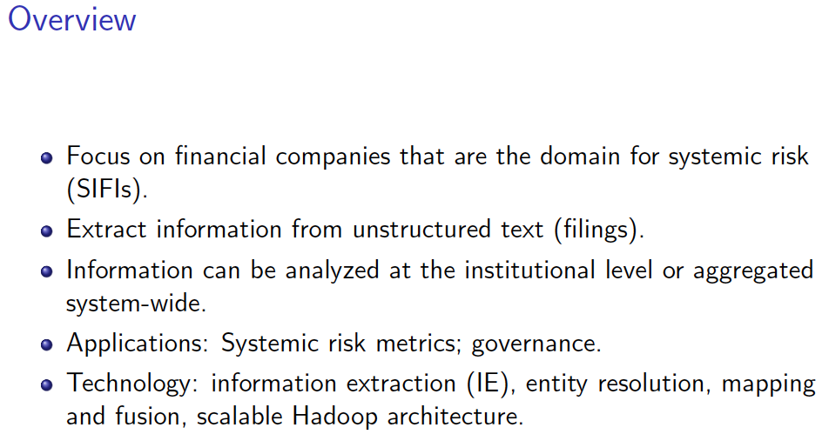

Slide 14
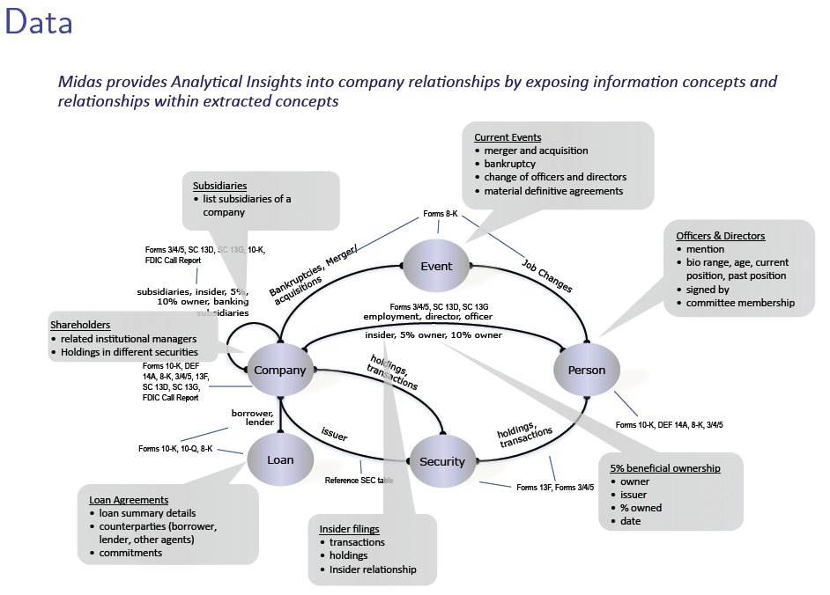

Slide 17
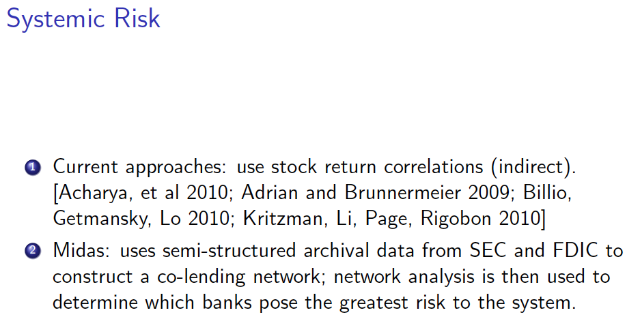

Slide 21
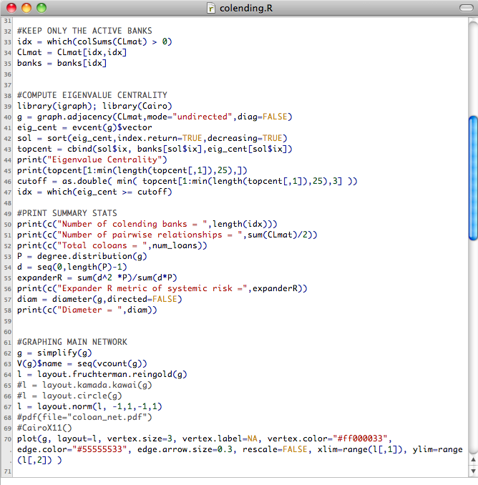

Slide 22
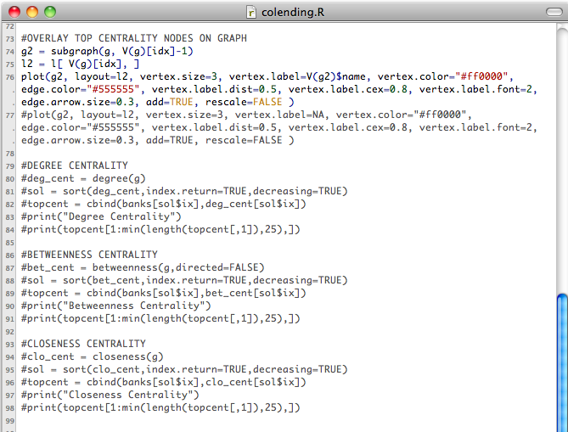

Slide 23
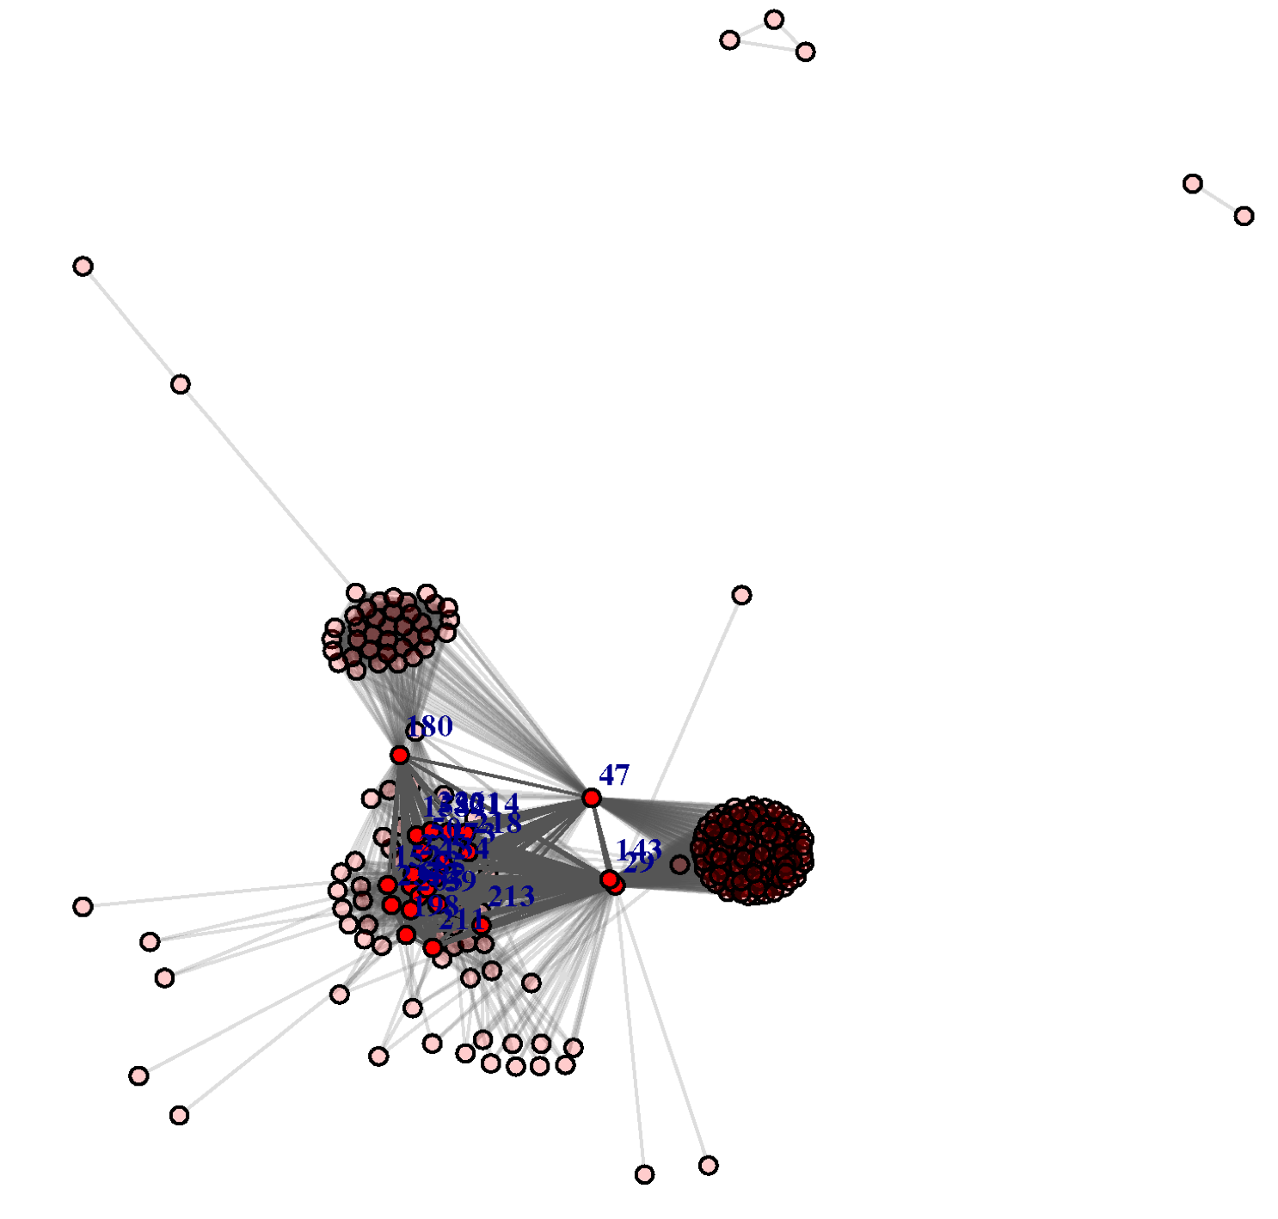
2005
Citigroup Inc.
J.P. Morgan Chase
Bank of America Corp.

Slide 24
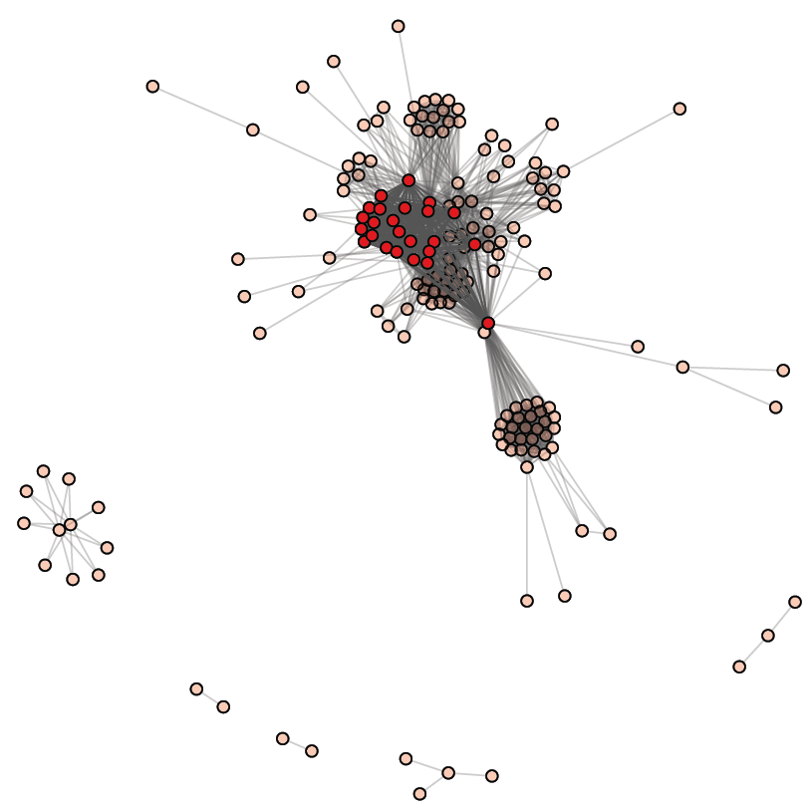
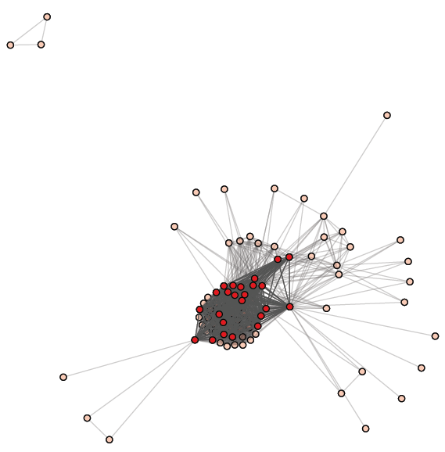
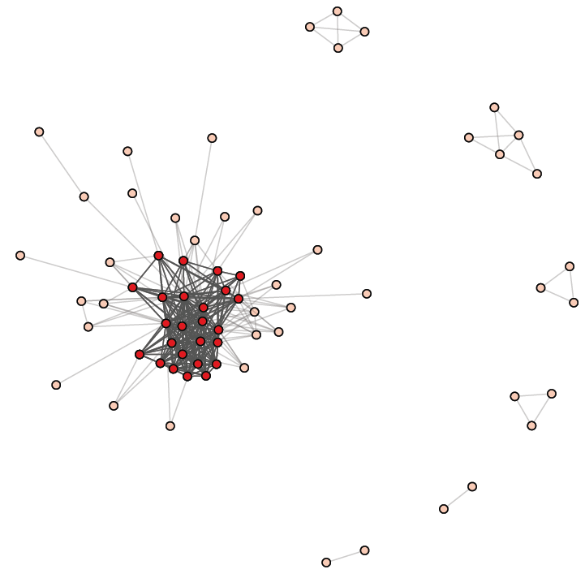
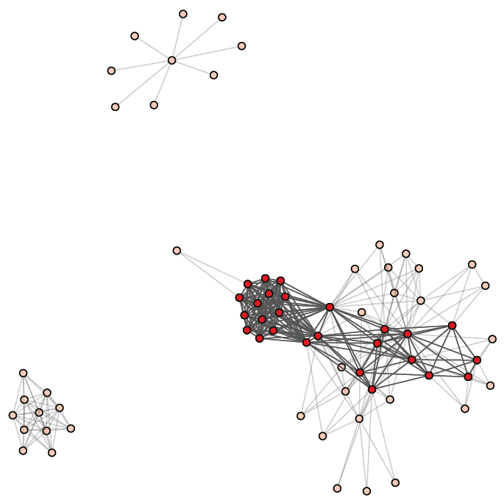
2006
2007
2008
2009

Slide 26
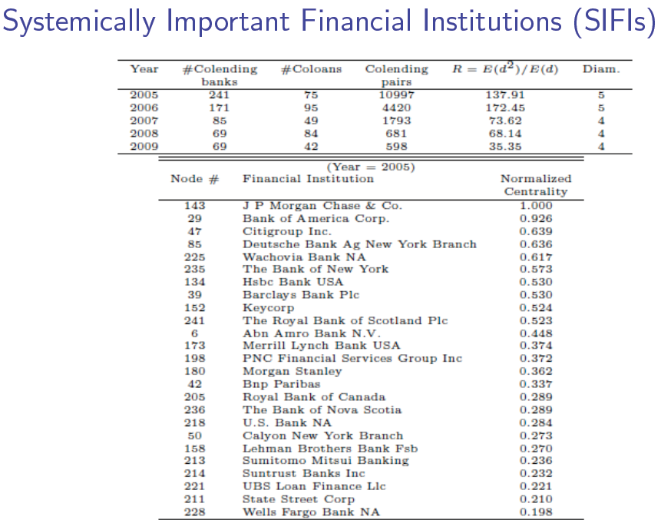

Slide 27
Modifying Home Loans with R models
THE PRINCIPAL PRINCIPLE: Optimal Modification of Distressed Home Loans (Why Lenders should Forgive, not Foresake Mortgages) [Journal of Financial and Quantiative Analysis, 2012]
STRATEGIC LOAN MODIFICATION: An Options based response to strategic default (joint work with Ray Meadows) [Journal of Banking and Finance, 2013]

Slide 30
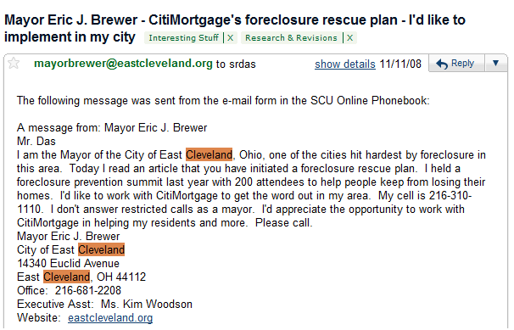

Slide 31
Game theoretic problem:
Lender determines the loan modification that maximizes value of loan given that the borrower will act strategically in his best interest.

Slide 32
Model
Home value
HJM
Correlation

Slide 33
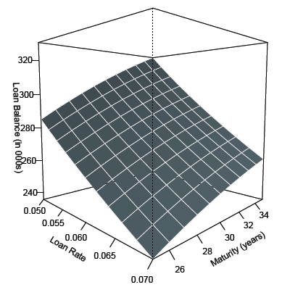
“Iso-Service” Surface
choose
Loan balance = $300,000
Home value = $250,000
Remaining maturity = 25 years
A = $1,933 per month
A_{max} = $20,000 per year
($1,667 per month)

Slide 34
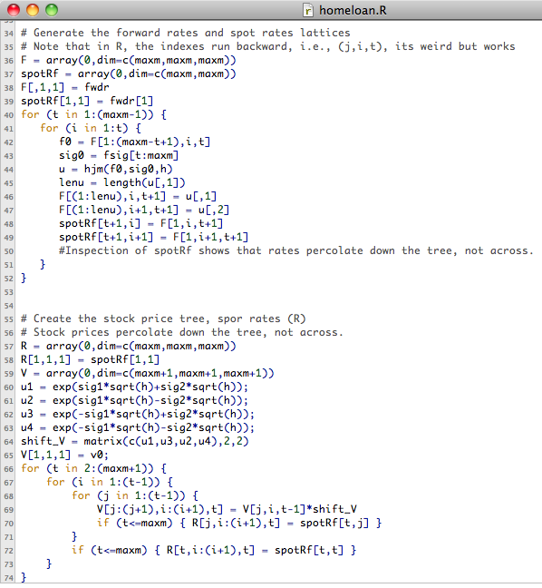
Some R

Slide 35
Cure risk and Re-default Risk
The risk of unnecessary relief, i.e., the borrower would not have ultimately defaulted.
Providing futile relief, leading to ultimate default anyway.
Value of loan accounting for willingness to pay
A: borrower income available for housing service, with mean μ and std. dev σ.

Slide 36
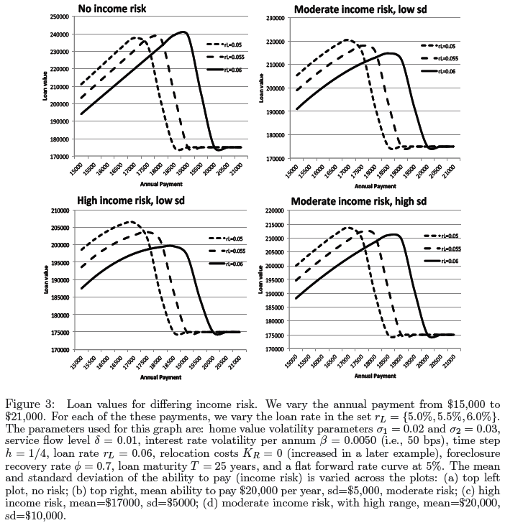

Slide 37
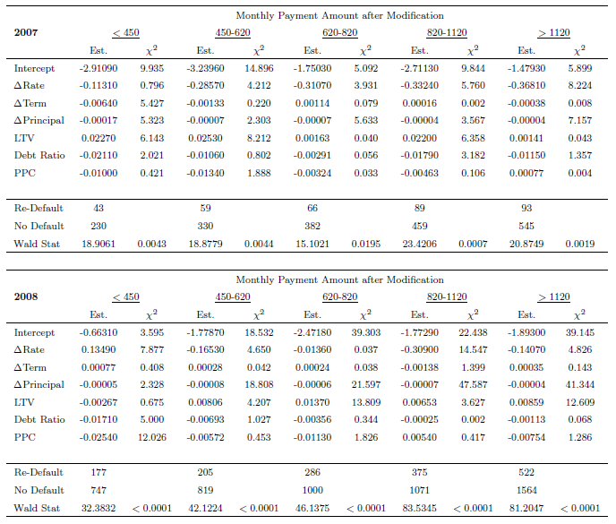
Logit: Explaining Re-default

Slide 38
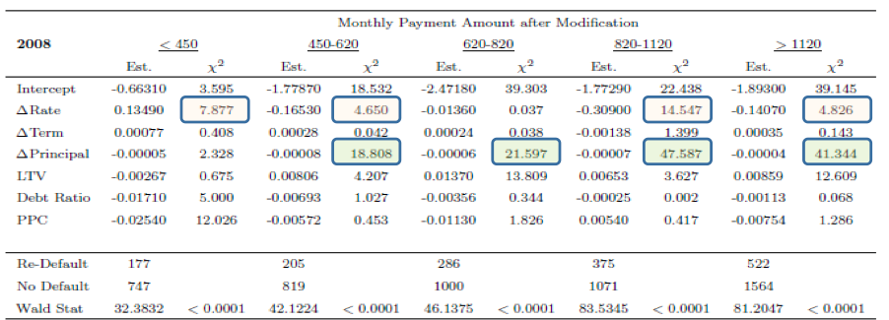

Slide 40
Portfolio Optimization using R
The research papers for this work are on my web page – just google it.
http://algo.scu.edu/~sanjivdas/research.htm/
Das, Markowitz, Scheid, and Statman (JFQA 2010), “Portfolio Optimization with
Mental Accounts”
2. Das & Statman (JEDC 2013), “Options and Structured Products in Behavioral Portfolios”

Slide 41
Standard Optimization Problem
Risk aversion
Mean
Covariance matrix
Portfolio weights
SOLUTION:
See Das, Markowitz, Scheid, Statman (JFQA 2010)

Slide 42
An alternate problem
For normal returns
Solve for γ

Slide 43
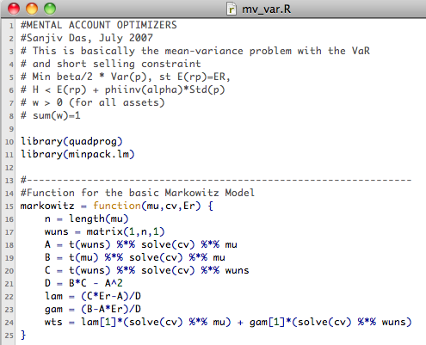

Slide 44
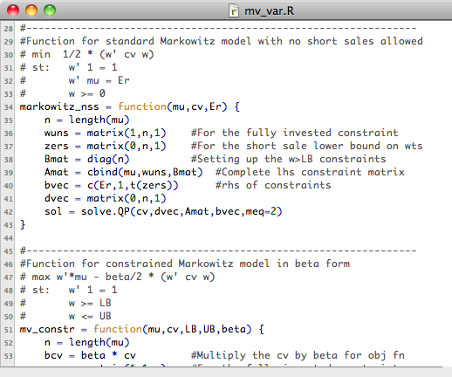

Slide 45
Sub-portfolios and overall portfolio
The expected return of the overall portfolio is the weighted average of the expected returns of the sub-portfolios.
The risk of the overall portfolio is not the weighted average of the risk of the sub-portfolios.

Slide 46
Real portfolios versus virtual portfolios

Slide 47
Risk as probability of losses
Mean-variance problem: Minimize Risk (variance) subject to minimum level of Expected Return.
Behavioral portfolio theory: Maximize Return subject to a maximum probability of falling below a threshold.

Slide 48
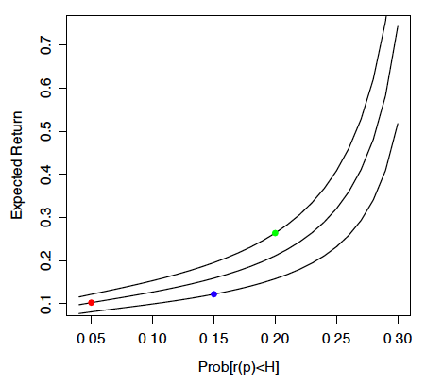
Efficient Frontiers in the BPT (Mental Account) World

Slide 49
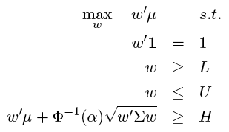
Short-Selling Constraints
Linear program with non-linear constraints. This is not a standard quadratic programming problem (QP) like the Markowitz model.
MVT uses a standard QP: quadratic objective function with linear constraints.

Slide 50
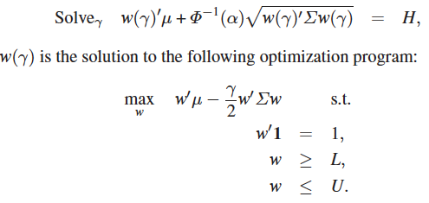
Modified Problem
Standard QP
Standard QP problem with linear constraints
Amenable to industrial optimizers; we use the R system with the quadprog package and minpack.lm library.

Slide 51
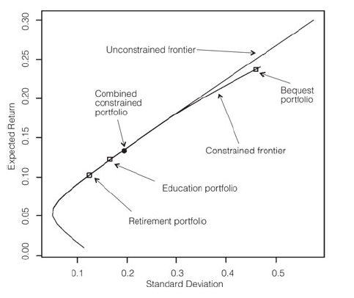
MV Frontier with Short-selling

Slide 52
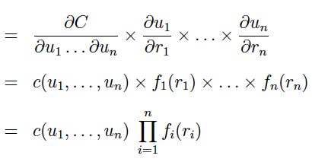
Deviating from Normality with Copulas

Slide 53
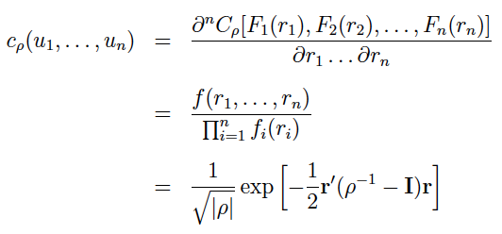
Gaussian Copula

Slide 54
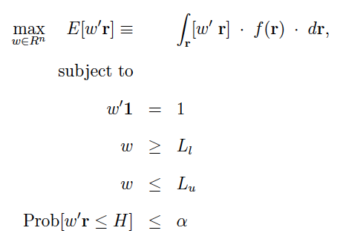
Extended Optimization Problem

Slide 55
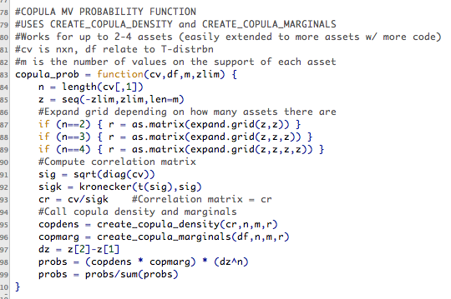

Slide 56
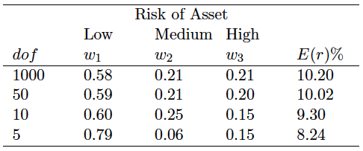
Solution

Slide 57
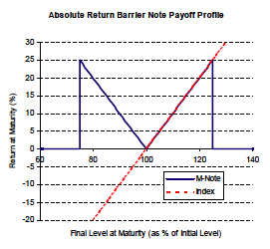
Structured Product: The Barrier-M-note

Slide 58
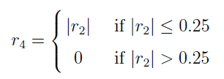
Barrier-M Note

Slide 59
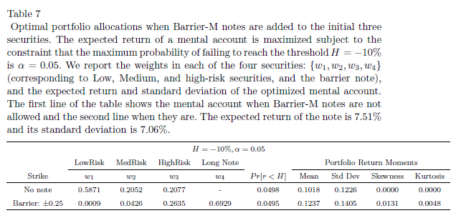
“Truncated Straddle”
Barrier-M-note
Return pick-up greater than 250 bps!

Slide 60
Venture Capital Communities
Joint work with Amit Bubna (Indian School of Business) & N.R. Prabhala (University of Maryland, National University of Singapore).

Slide 61
Syndication

Slide 67
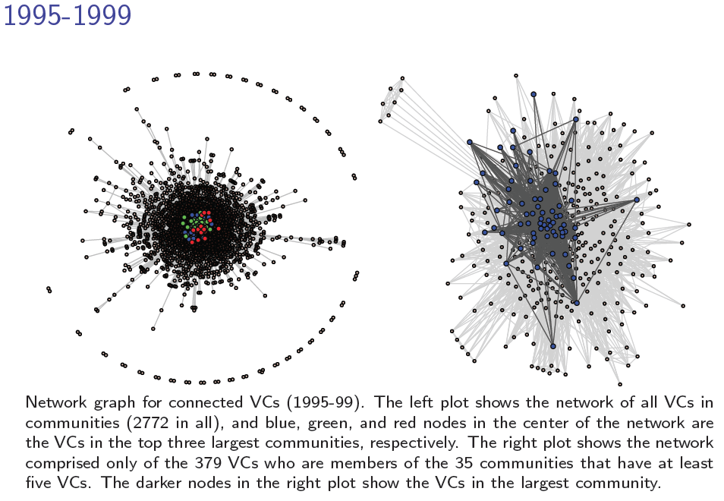

Slide 68
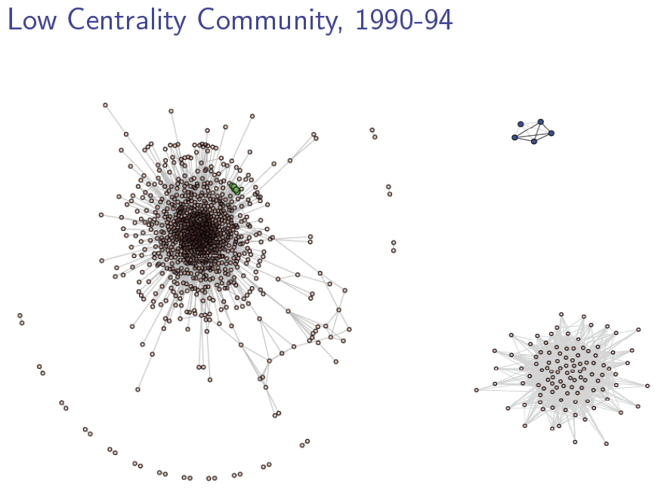

Slide 69
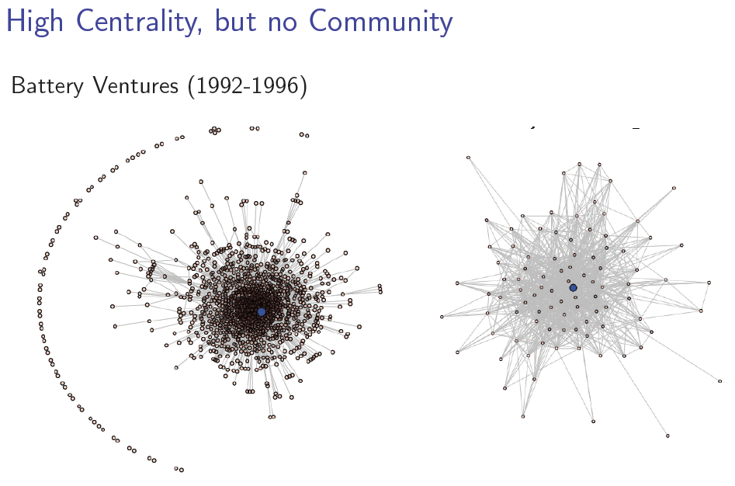

Slide 70
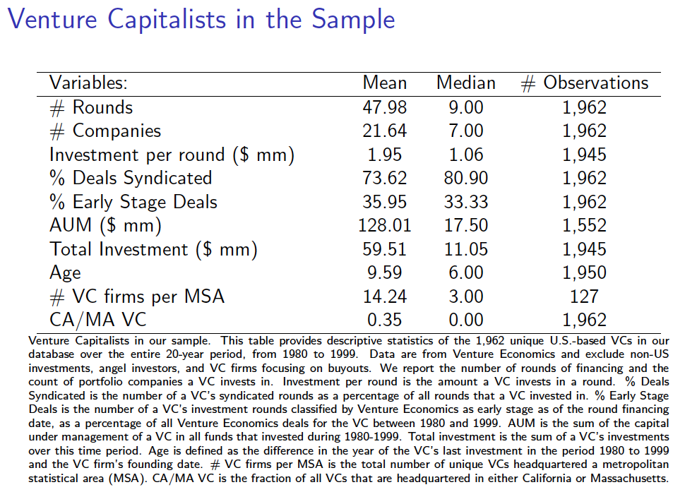

Slide 71
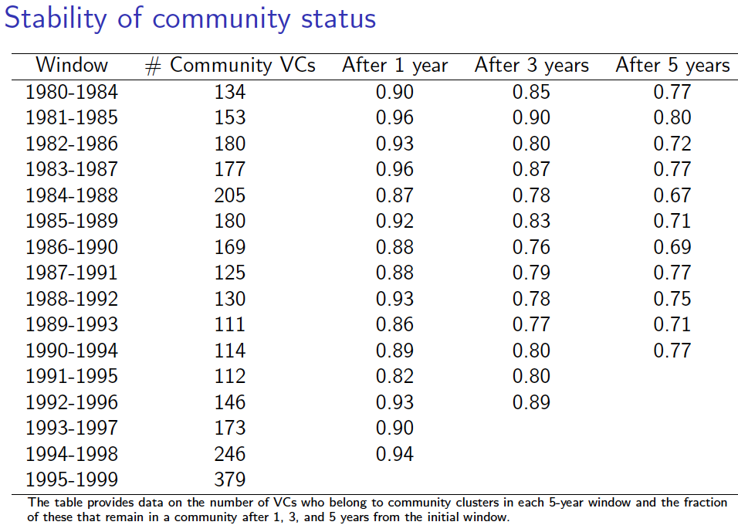

Slide 73
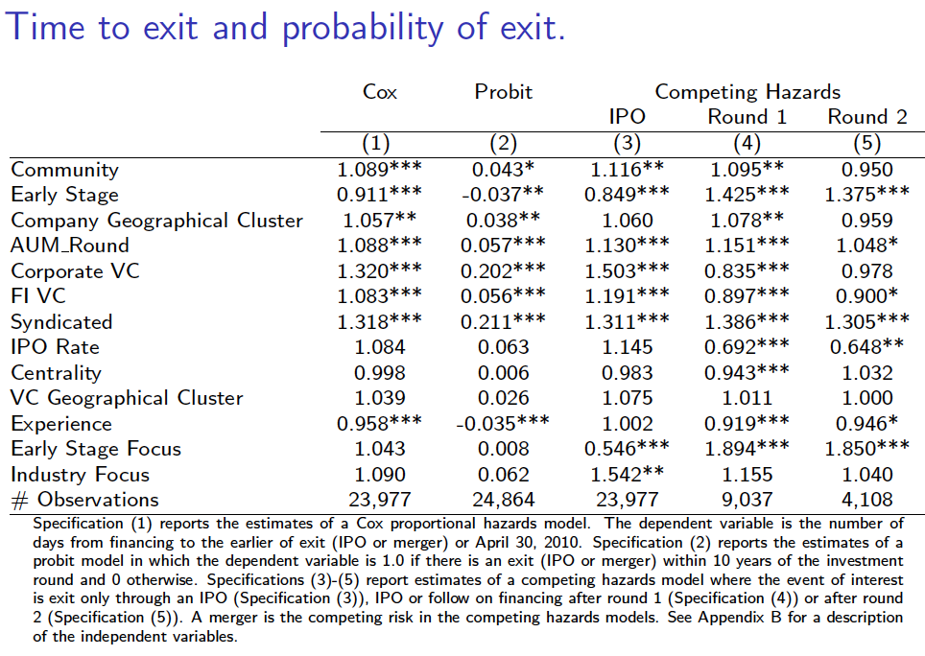

Slide 75
PEDAGOGICAL USES FOR R USING THE WEB
http://sanjivdas.wordpress.com/

Slide 76
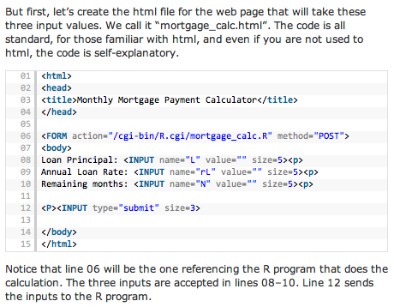
Use the Rcgi package from David Firth: http://www.omegahat.org/CGIwithR/
You need two program files to get everything working.
(a) The html file that is the web form for input data.
(b) The R file, with special tags for use with the CGIwithR package.

Slide 77
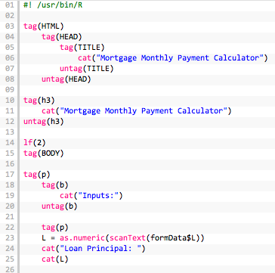
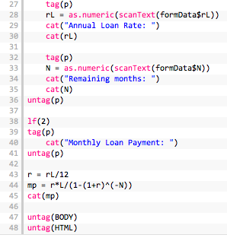
R Code called from CGI

Slide 78
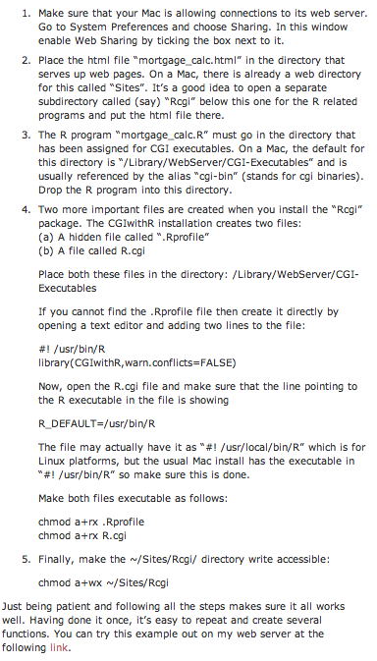
http://algo.scu.edu/~sanjivdas/Rcgi/mortgage_calc.html
Notes:
http://algo.scu.edu/~sanjivdas/derbook/ps_oneprob.html

Slide 79
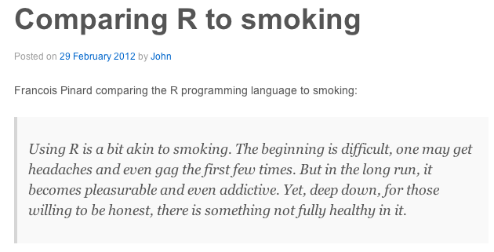

Slide 80
High-performance computing (parallelR)
Community detection
Network modeling
Q?
Optimization
Web functions
Calling C from R
Lattice dynamic optimization
High-dimensional distributions with copulas

