Slide 1
Price Discovery Share: An Order Invariant Measure of Price Discovery with Application to Exchange-Traded Funds
By
Syed Galib Sultan
University of Washington
and
Eric Zivot
University of Washington

Slide 2
Price Discovery
Price discovery is commonly defined as the process by which new information is impounded into different asset prices through trading activity.
In empirical models two kinds of shocks affect asset prices:
(1) transient or noise shock;
(2) permanent or information shock.
When a price receives a permanent shock it changes permanently from old equilibrium to new equilibrium. Price discovery measures should tell us which asset price moves more to reflect this new information.

Slide 3
Hasbrouck’s Cointegration Framework
arbitrage linked prices s.t.
n-1 cointegrating vectors with basis

Slide 4
Wold Representation and BN Decomposition

Slide 5
Permanent Shock Model

Slide 6
How to estimate Ψ(1)
Empirical vector error correction model (VECM) with known cointegrating vector
Use R package urca to estimate empirical VECM

Slide 7
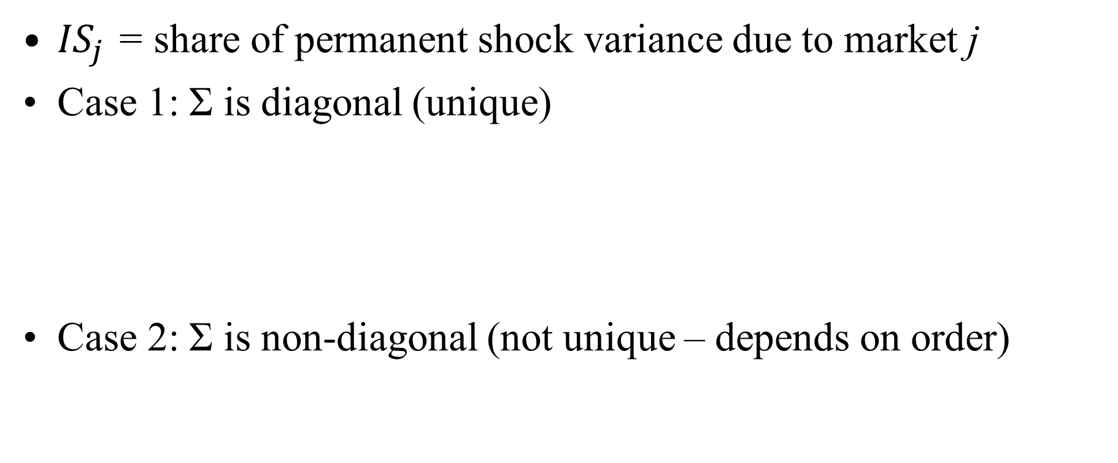
Hasbrouck' s Information Share (IS)
${IS}_{j}$ = share of permanent shock variance due to market j
Case 1: Σ is diagonal (unique)
Case 2: Σ is non-diagonal (not unique – depends on order)

Slide 8
New Order Invariant Price Discovery Share Measure
Euler’s theorem gives the additive decomposition
Define price discovery share (PDS) for market j as

Slide 9
Properties of PDS
Closely related to IS
Order invariant
Equivalent to IS when Σ is diagonal
Computation is done in R package priceDiscovery (under development)
Functions for computing a wide variety of price discovery measures

Slide 10
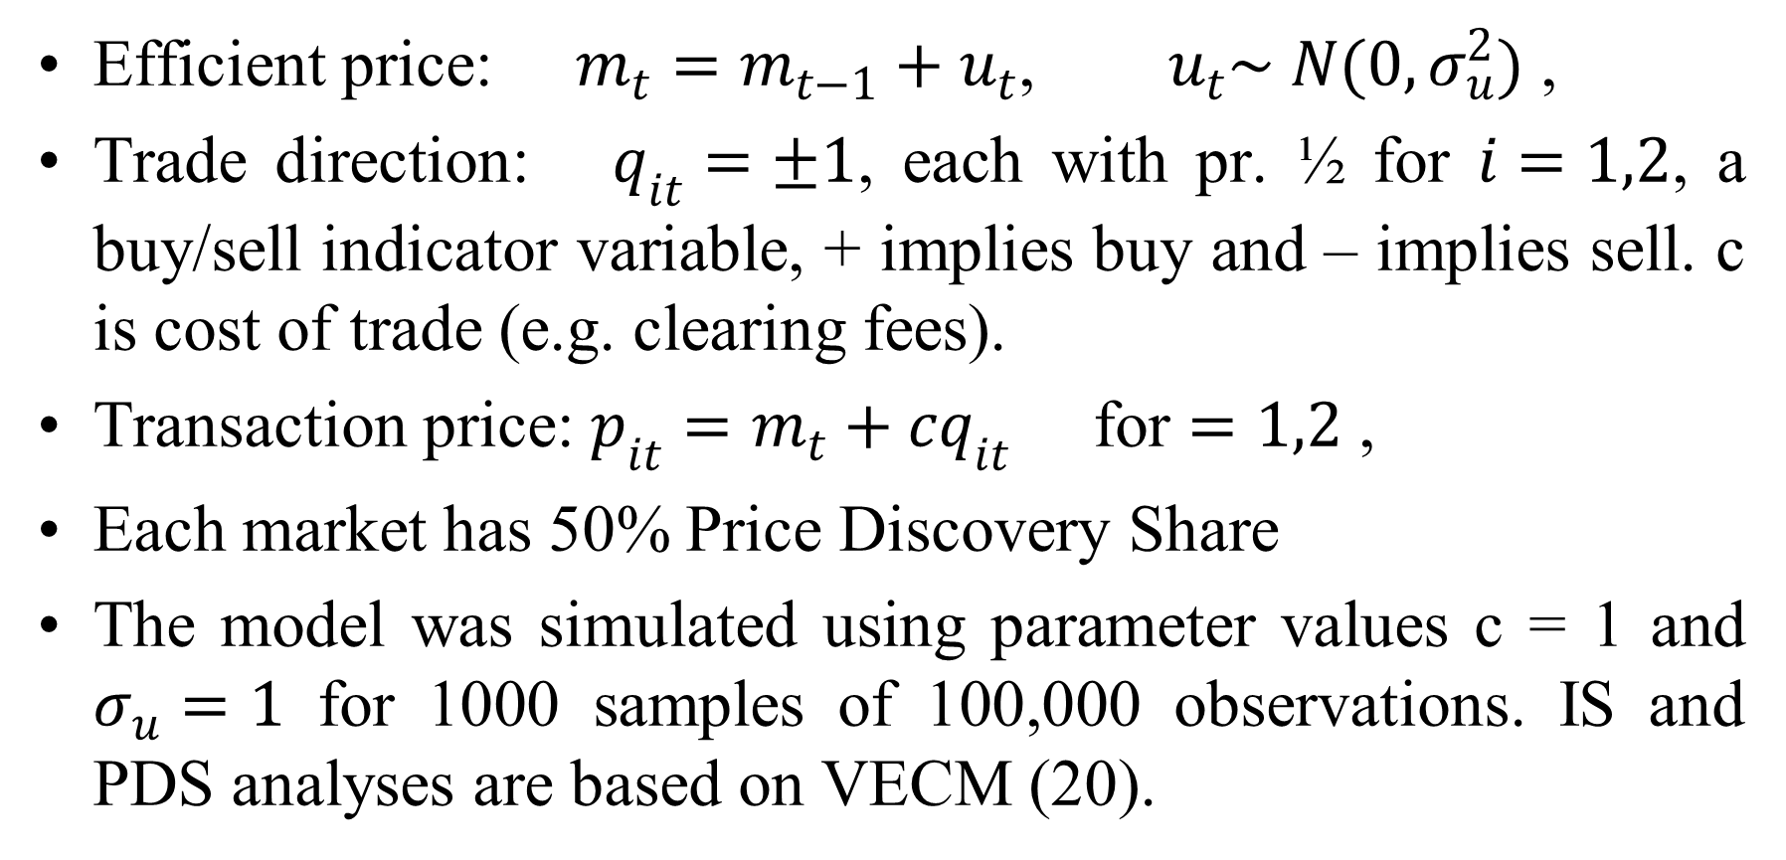
Simulation: A two-market “Roll” model
Efficient price: $m_{t}=m_{t−1}+u_{t}$, $u_{t}\sim N(0,σ_{u}^{2})$ ,
Trade direction: $q_{it}=±1$, each with pr. ½ for $i=1,2$, a buy/sell indicator variable, + implies buy and – implies sell. c is cost of trade (e.g. clearing fees).
Transaction price: $p_{it}=m_{t}+cq_{it}$ for $=1,2$ ,
Each market has 50% Price Discovery Share
The model was simulated using parameter values c = 1 and $σ_{u}=1$ for 1000 samples of 100,000 observations. IS and PDS analyses are based on VECM (20).

Slide 11
Simulation: A two-market “Roll” model
Structural price discovery share of market 1 = 0.5 | Hasbrouck (1995) model: IS for Market 1
 | IS upper bound | IS lower bound | PDS
Mean | 0.78 | 0.21 | 0.501
Standard Deviation | 0.011 | 0.011 | 0.017
95% confidence interval | [0.766, 0.812] | [0.188, 0.235] | [0.466, 0.535]
Upper bound minus lower bound is wide and not informative
PDS gives accurate estimate

Slide 12
Empirical Application: Exchange-Traded Funds (ETFs)
A security that tracks an index but trades like a stock on an exchange.
Diversification, low expense ratio, and tax efficiency make ETFs attractive for investment and risk management purposes.
Flash crash on May 6, 2010 is attributed to failure in price discovery of ETFs.

Slide 13
Empirical Application: ETFs
“Duplication of ETFs”: Proliferation of ETFs that track the same index.
SPY (SPDR), IVV (iShares) and VOO (Vanguard) track S&P 500 index.
IWM (iShares), VTWO (Vanguard) and TWOK (SPDR) track Russell 2000 index .
QQEW (First Trust) and QQQE (Direxion) track NASDAQ-100 equal weighted index.

Slide 14
Empirical Application: Questions of Interest
Does the proliferation of identical or closely related ETFs adversely affect the price discovery process?
Which ETF is the price leader/follower among identical ETFs in different markets and market conditions?
Which ETF price serves as a dominant source of information in S&P 500 ETF trading?

Slide 15
Choice of ETFs for Study
We choose SPY and IVV for our empirical exercise since they are almost similar in terms of portfolio weights, prices (roughly 1/10th of S&P 500 index) and expense ratios. Majority of trade volume occurs in these two ETFs.
Marshal et al. (2013): Traders treat SPY and IVV as perfect substitutes but they are not. Arbitrage opportunity between SPY and IVV arises from mispricing.
SPY and IVV prices are co-integrated with co-integrating vector (1,-1)’. The difference between two prices does not drift far apart from each other and it is I(0).

Slide 16
SPY vs. IVV
 | SPY | IVV
Overview
Issuer | State Street SPDR | BlackRock iShares
Inception | 22, Jan-1993 | 15, May-2000
Asset Under Management | $165,308.6 M | $61,743.0 M
Shares Outstanding | 868.6 M | 322.3 M
Expense Ratio | 0.09% | 0.07%
Source: ETF database. All the results are reported on October 21st, 2014

Slide 17
Top 10 holdings: SPY vs. IVV
Stock | SPY | IVV
Apple Inc | 3.43% | 3.44%
Exxon Mobil Corporation | 2.28% | 2.28%
Microsoft Corporation | 2.17% | 2.18%
Johnson & Johnson | 1.71% | 1.71%
General Electric Co | 1.46% | 1.46%
Berkshire Hathaway class B | 1.43% | 1.43%
Wells Fargo & Co | 1.40% | 1.40%
Procter & Gamble Co | 1.29% | 1.29%
Chevron Corp | 1.29% | 1.29%
JPMorgan Chase & Co | 1.29% | 1.29%

Slide 18
Empirical Application: Exchange-Traded Funds (ETFs)
Three snap-shots of data (mid-quotes every second in each day from 9:30 am to 16:30 pm - 25201 observations every day)
Normal Trading Period: Dec 3rd - Dec 7th , 2012 – low volatility
Abnormal Trading Period # 1: May 6th, 2010. Flash Crash – High volatility
Abnormal Trading Period # 2: Aug 8th, 2010. US lost its AAA credit rating – High volatility
Eight different stock exchanges: BATS, Nasdaq, Arca, EDGE A, CBOE, NSX, Boston, and Philadelphia.

Slide 19
ETF Activity on Normal and Abnormal Days
Stock Exchanges | Date | Ratio of Numbers Shares Traded in SPY and IVV | Average Bid-Ask of SPY (IVV)
NASDAQ | Dec 3-7, 2012 (Normal) | 20.7 | 0.01 (0.02)
 | May 6, 2010 (Flash Crash) | 53.5 | 0.02 (0.09)
 | Aug 8, 2011 (loss of AAA) | 31.8 | 0.01 (0.04)
BATS | Dec 3-7, 2012 (Normal) | 19.6 | 0.01 (0.02)
 | May 6, 2010 (Flash Crash) | 26.8 | 0.02 (0.07)
 | Aug 8, 2011 (loss of AAA) | 39.6 | 0.01 (0.04)
Arca | Dec 3-7, 2012 (Normal) | 35.8 | 0.01 (0.03)
 | May 6, 2010 (Flash Crash) | 52.6 | 0.02 (0.07)
 | Aug 8, 2011 (loss of AAA) | 38.2 | 0.01 (0.04)

Slide 20
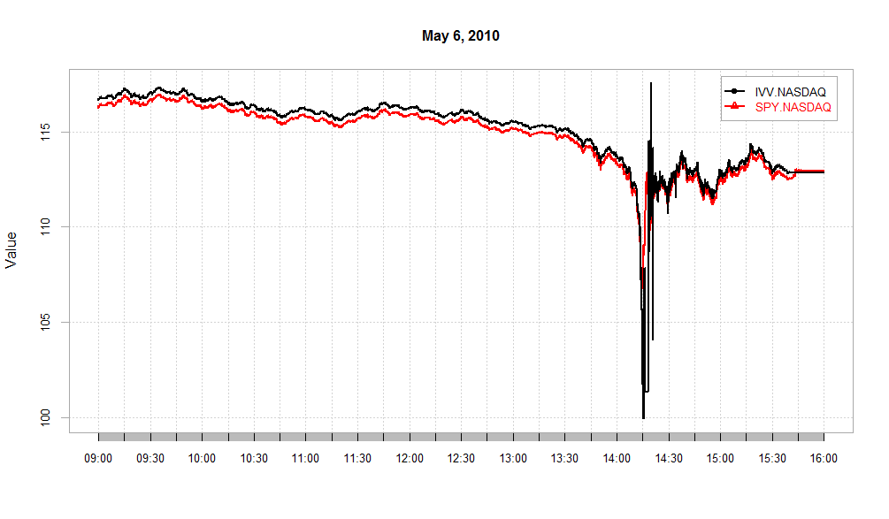
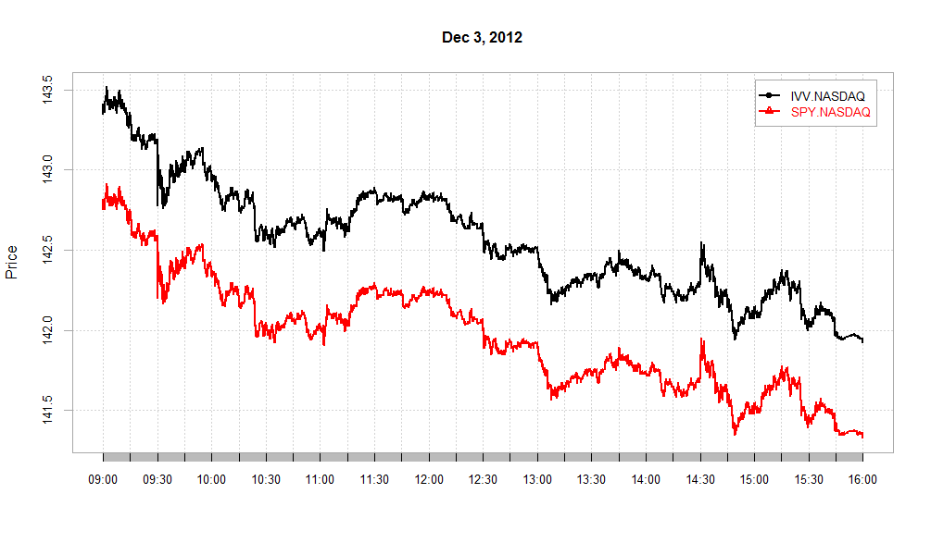
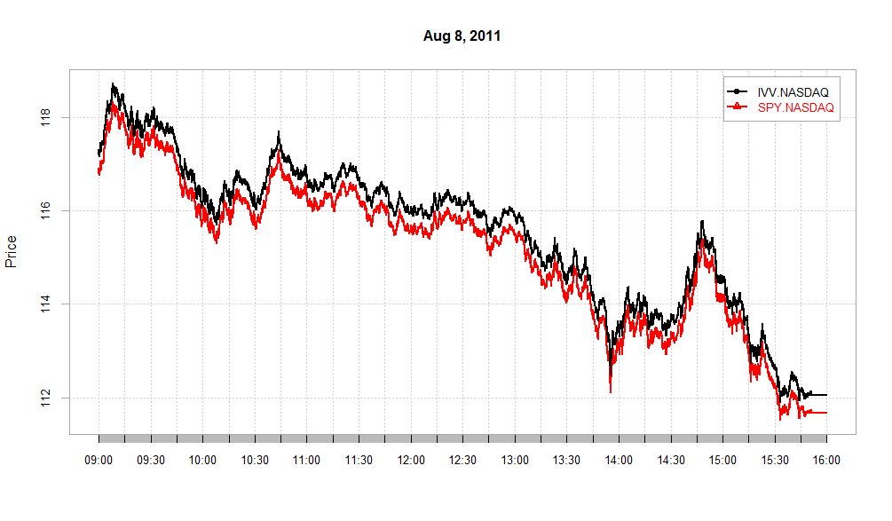
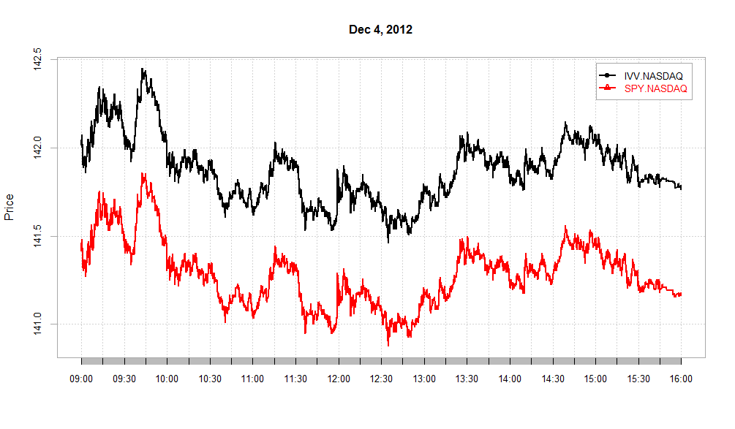
SPY and IVV in NASDAQ (Mid quotes)
Flash Crash
Normal
Loss of AAA
Normal
Data cleaning performed using the R package highFrequency

Slide 21
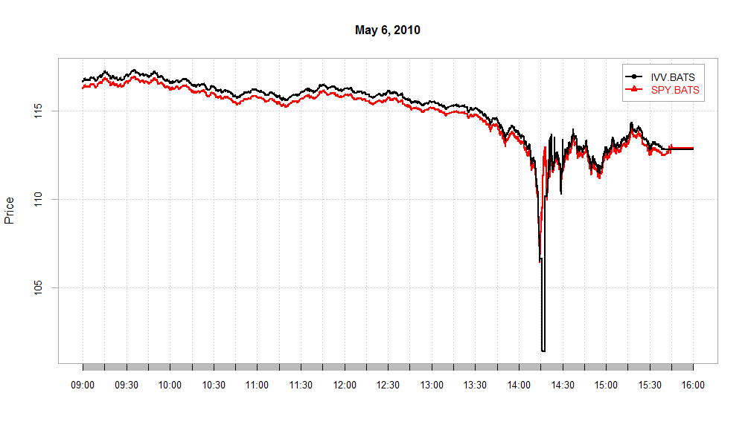
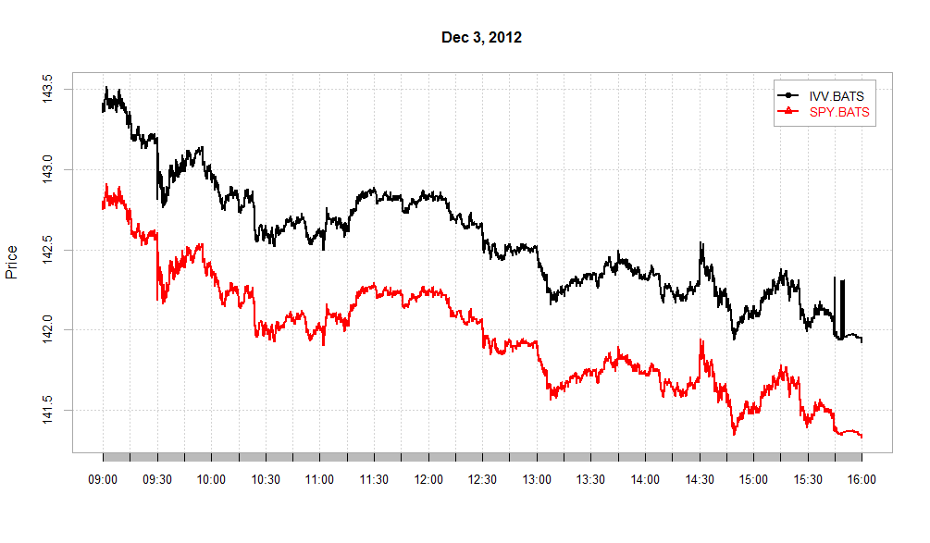
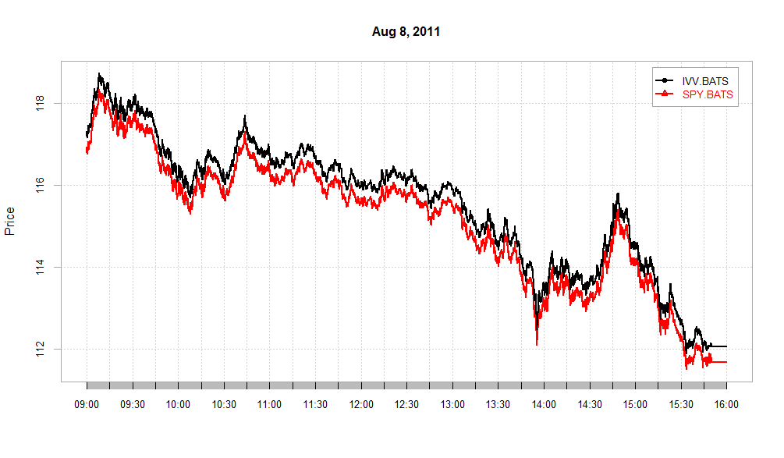
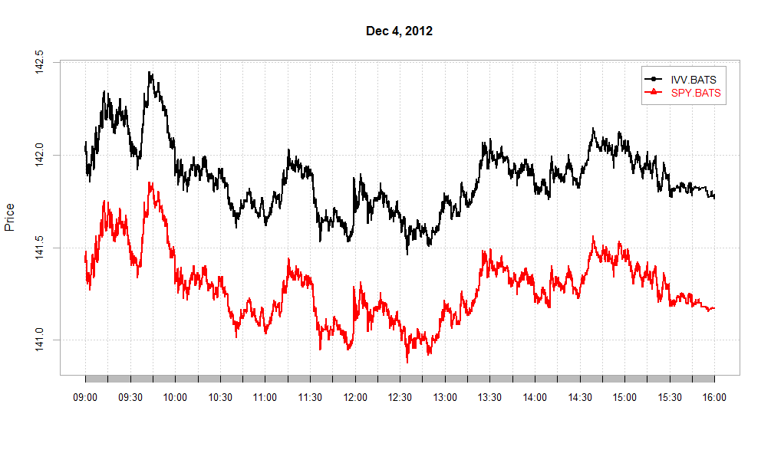
SPY and IVV in BATS (Mid quotes)

Slide 22
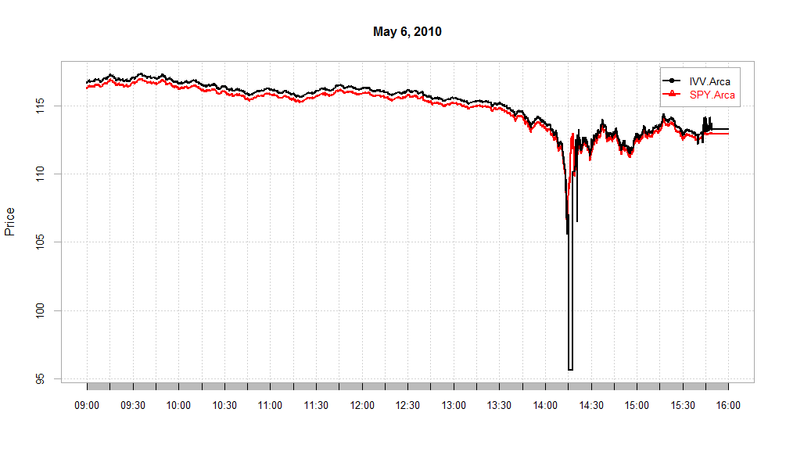
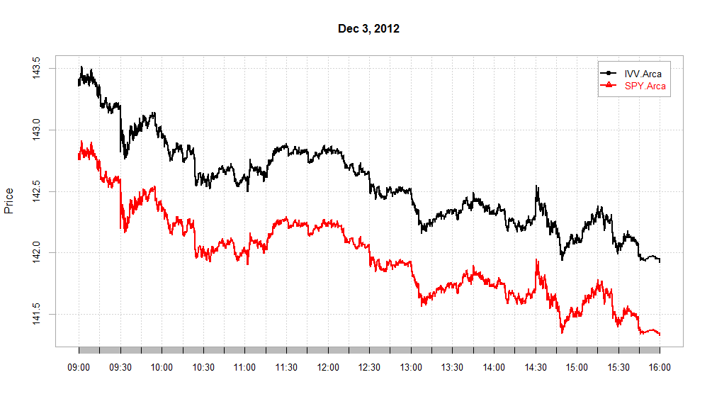
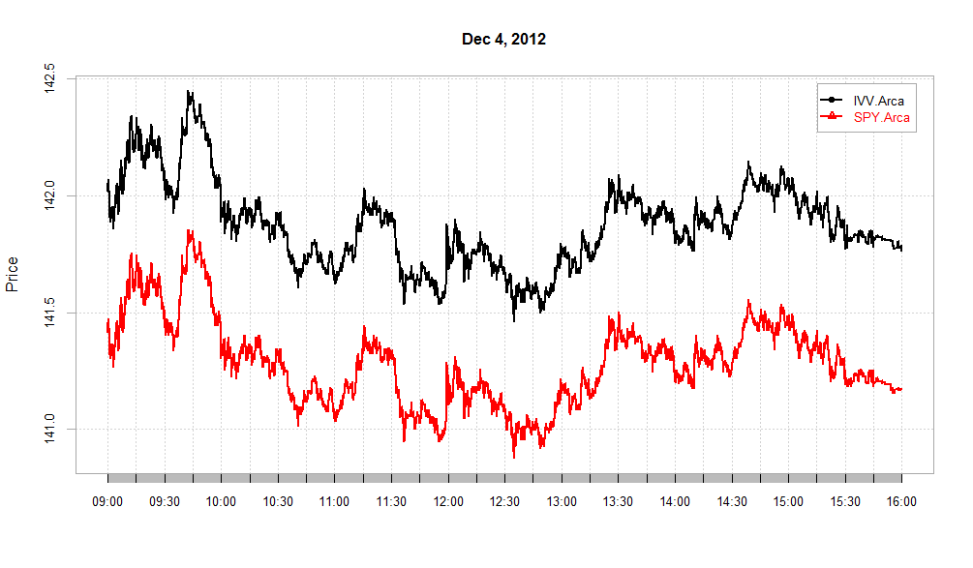
SPY and IVV in Arca (Mid quotes)

Slide 23
IS vs PDS in Different Exchanges
Single day from the normal trading week (3rd December, 2012).
IS and PDS for SPY and IVV in eight different stock exchanges
BATS, Nasdaq, Arca, EDGE A, CBOE, NSX, Boston, Philadelphia.
IS gives a wide and uninformative range of price discovery contributions in most markets.

Slide 24
IS vs PDS in Different Exchanges: Dec 3, 2012
Stock Exchange | ETF | IS - Upper bound | IS - Lower bound | PDS
NASDAQ | SPY | 0.92 (0.02) | 0.13 (0.02) | 0.58 (0.02)
 | IVV | 0.87 (0.02) | 0.08 (0.02) | 0.42 (0.02)
BATS | SPY | 0.98 (0.02) | 0.57 (0.02) | 0.90 (0.02)
 | IVV | 0.43 (0.02) | 0.02 (0.02) | 0.10 (0.02)
Arca | SPY | 0.92 (0.01) | 0.14 (0.01) | 0.59 (0.01)
 | IVV | 0.86 (0.02) | 0.08 (0.02) | 0.41 (0.02)
Chicago Board Option Exchange (CBOE) | SPY | 0.96 (0.02) | 0.52 (0.02) | 0.85 (0.02)
 | IVV | 0.48 (0.02) | 0.04 (0.02) | 0.15 (0.02)

Slide 25
IS vs PDS in Different Exchanges: Dec 3, 2012
Stock Exchange | ETF | IS - Upper bound | IS- Lower bound | PDS
National Stock Exchange (NSX) | SPY | 0.99 (0.00) | 0.99 (0.00) | 0.99 (0.00)
 | IVV | 0.01 (0.00) | 0.01 (0.00) | 0.01 (0.00)
Boston Stock Exchange | SPY | 0.78 (0.02) | 0.11 (0.02) | 0.40 (0.02)
 | IVV | 0.89 (0.02) | 0.22 (0.02) | 0.60 (0.02)
Philadelphia Stock Exchange | SPY | 0.87 (0.02) | 0.20 (0.02) | 0.56 (0.02)
 | IVV | 0.80 (0.02) | 0.13 (0.02) | 0.44 (0.02)
EDGE A Stock Exchange | SPY | 0.87 (0.02) | 0.42 (0.02) | 0.68 (0.02)
 | IVV | 0.58 (0.02) | 0.13 (0.02) | 0.32 (0.02)

Slide 26
PDS for SPY and IVV in Different Market Conditions
Normal Trading Period: Dec 3rd - Dec 7th , 2012
Abnormal Trading Period # 1: May 6th, 2010. Flash Crash –
Abnormal Trading Period # 2: Aug 8th, 2010. US lost its AAA credit rating
PDS for SPY and IVV in three most active stock exchanges
BATS, Nasdaq, Arca
PDS for SPY is slightly larger on normal days but substantially larger on abnormal days

Slide 27
PDS between SPY and IVV
Stock Exchange | Vectors of Prices | Daily average of PDS on Dec 3rd -7th, 2012 | PDS on May 6th, 2010 (Flash-Crash) | PDS on Aug 8th, 2011
NASDAQ | SPY | 0.53 | 0.92 (0.002) | 0.83 (0.009)
 | IVV | 0.47 | 0.08 (0.002) | 0.17 (0.009)
BATS | SPY | 0.59 | 0.99 (0.005) | 0.62 (0.012)
 | IVV | 0.41 | 0.01 (0.005) | 0.38 (0.012)
Arca | SPY | 0.62 | 0.93 (0.005) | 0.79 (0.0016)
 | IVV | 0.38 | 0.07 (0.005) | 0.021 (0.0016)

Slide 28
Conclusion
A new order invariant empirical measure for price discovery.
Performs better than IS in simulation.
SPY is found to contribute more in price discovery than IVV, and the contribution becomes very asymmetric during abnormal trading periods.

