Slide 1
Global Adaptive Asset Allocation, and the Possible End of Momentum
By: Ilya Kipnis
www.quantStratTrader.wordpress.com
Ilya.Kipnis@gmail.com

Slide 2
The Assets (From Meb Faber’s GAA book)
Found in Faber 2015—Global Asset Allocation
"SPY", "IWM", "EFA", "EEM", "LQD", "SHY", "IEF", "TLT", "BWX", "TIP", "DBC", "GLD", "VNQ"

Slide 3
The Methodology (ReSolve Asset Mgmt AAA)
A general overview found in Butler, Philbrick, and Gordillo (2016) – Adaptive Asset Allocation
Momentum
Mean-Variance Optimization Risk Management (of some sort)

Slide 4
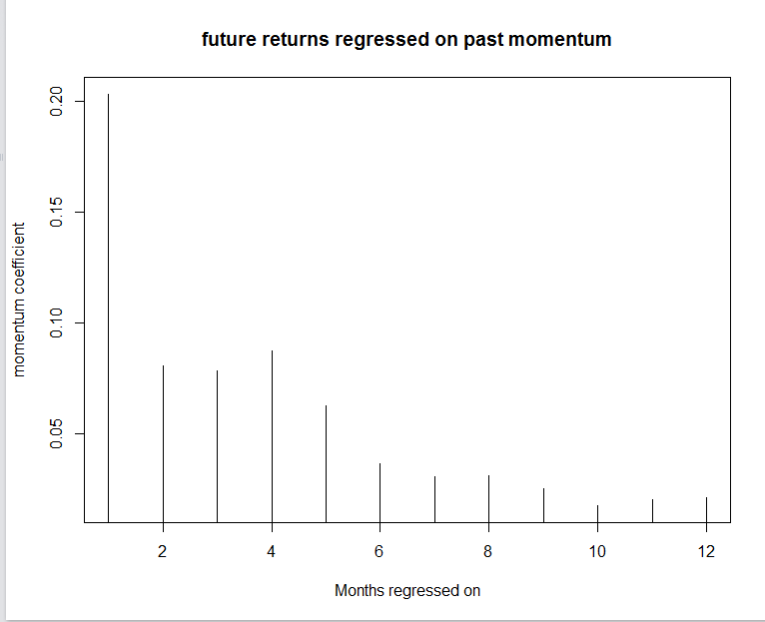
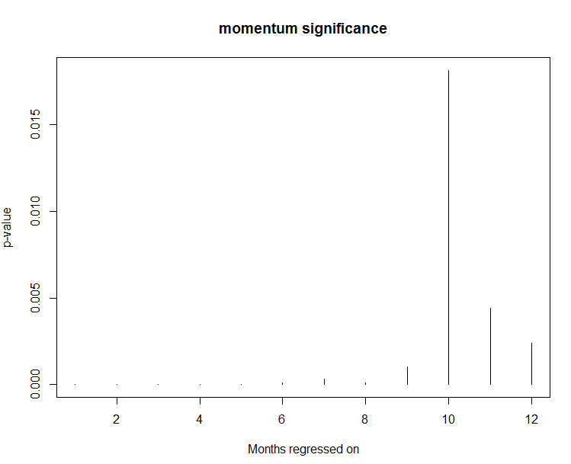
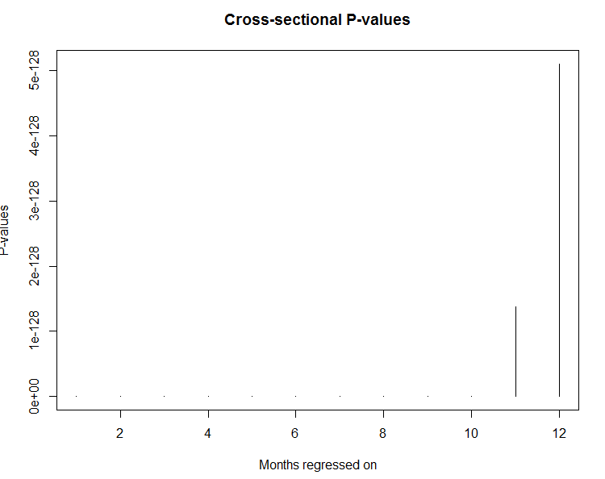
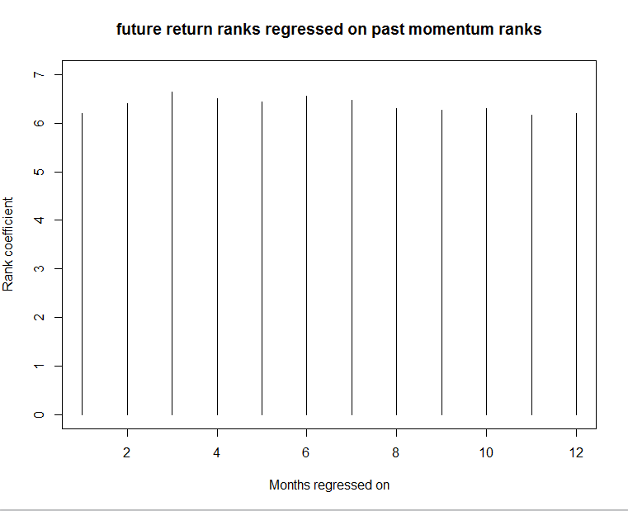
Momentum Significance

Slide 5
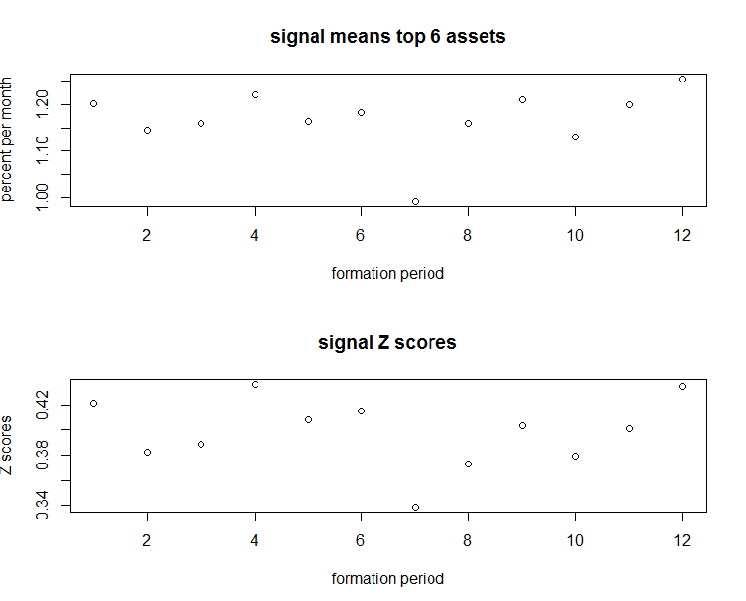
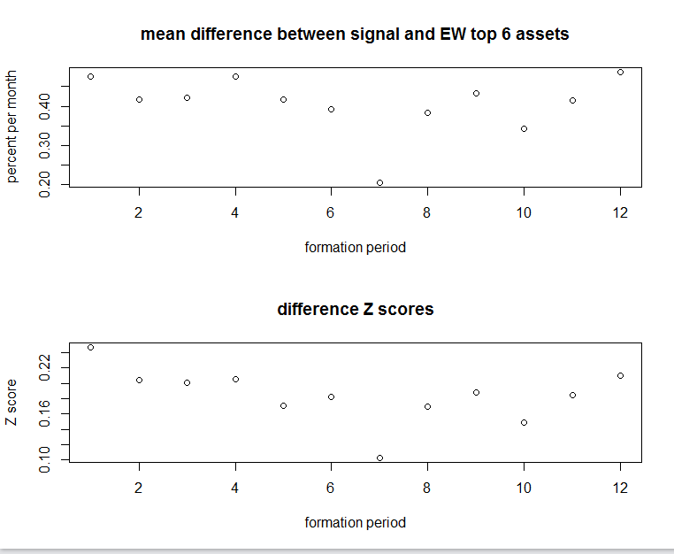
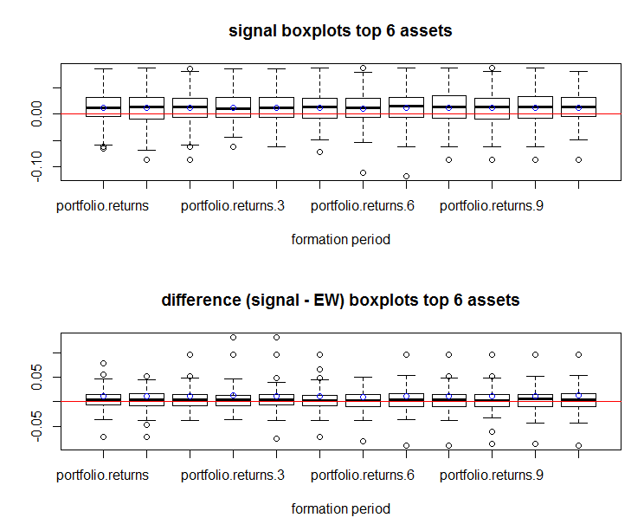
Top 6 Assets Perform Well vs. EW of all 13

Slide 6
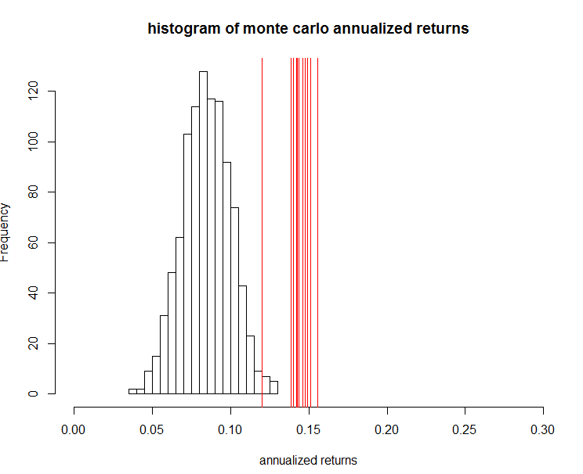
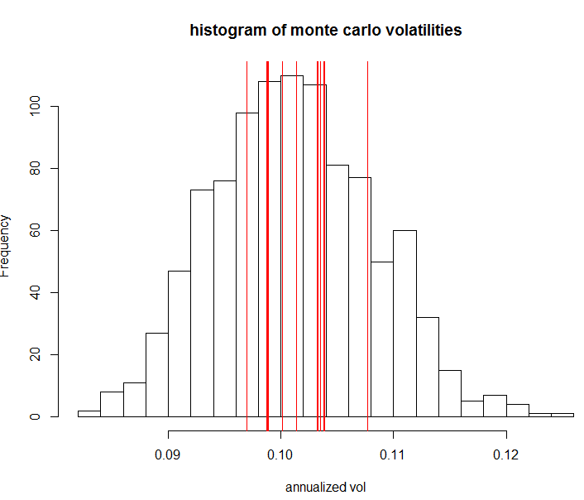
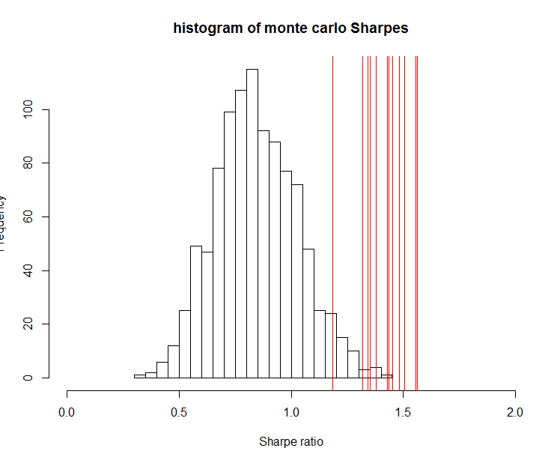
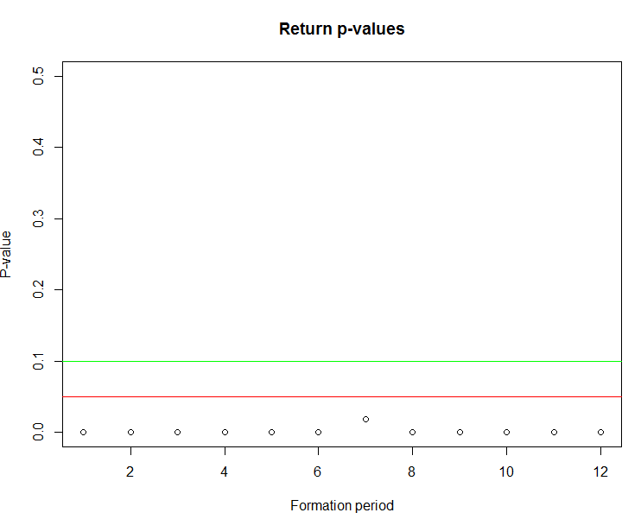
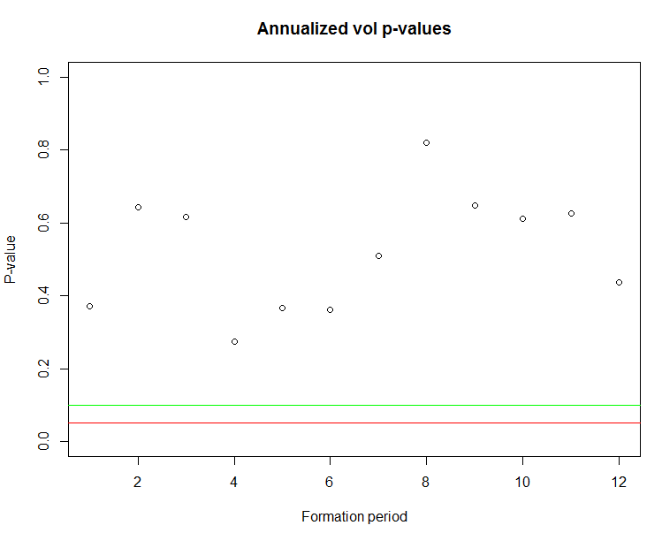
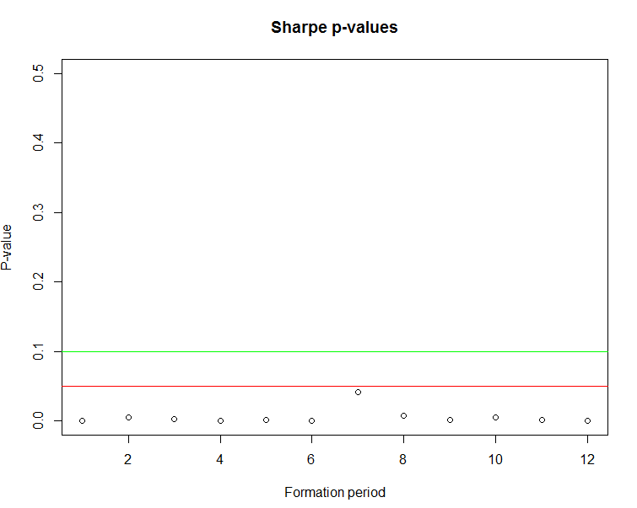
Monte Carlo Results

Slide 7
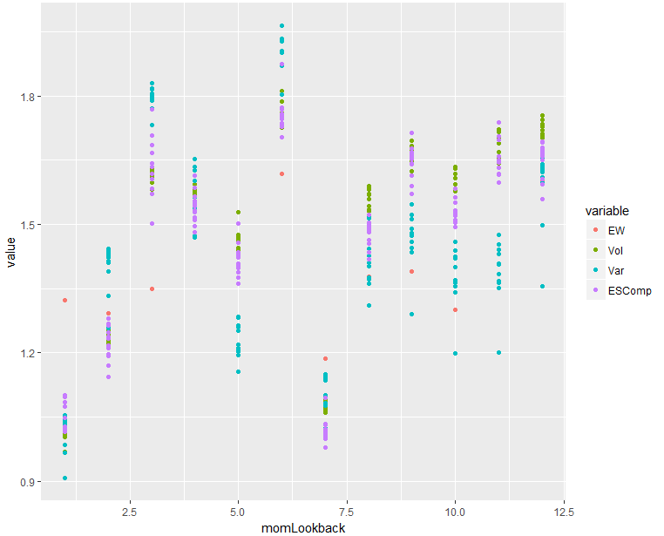
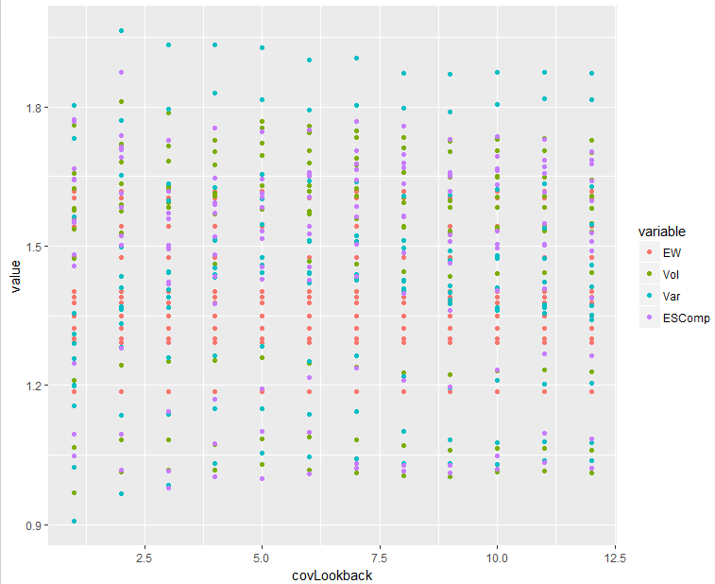
Which Lookbacks Mattered?
Risk management algos: inverse sample vol, normalized 1.25 – max component ES, Varadi max decorrelation algo.
Momentum lookback matters.
Which risk management scheme used mattered (anything but EW).
Variance/covariance lookback? Not so much.

Slide 8
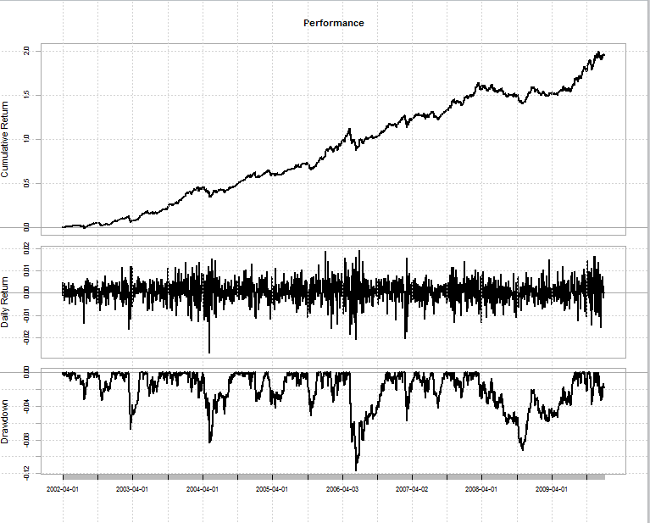
Final (In-Sample) Strategy (April 2002-Dec 2009)
Annualized Sharpe Ratio (Rf=0%) 0.0006701604
Equal Weight 3, 6, 9, 12 month momentum lookbacks using all 12 monthly lookbacks for risk management computation, with all three schemes (inverse vol, max ES normalization, Varadi).
I.E.: allocate equally among all the permutations, indifferent to any particular one.
Annualized Sharpe: 1.88
Deflated Sharpe Ratio P-value: .0006701604
Highly statistically significant evidence of
non-random performance.

Slide 9
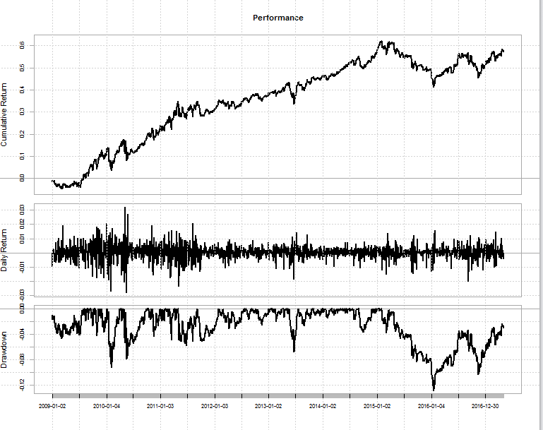
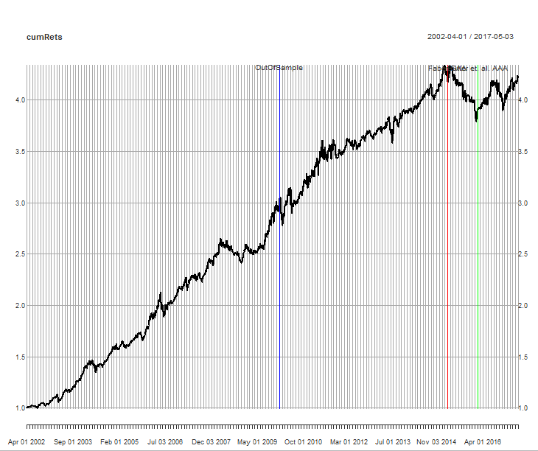
Out of Sample?
Significant deterioration.
In-sample statistics: 14.4% CAGR, 7.66% vol, 1.88 Sharpe
Out-of-Sample: 5.59% CAGR, 7.94% vol, .7 Sharpe
Blue: Out of Sample. Red: Faber (2015) Green: Adaptive Asset Allocation (2016)

Slide 10
Thank You
Contact: ilya.Kipnis@gmail.com
Blog/portfolio: www.quantStratTrader.wordpress.com

