Slide 1
Bond Lab®
Fixed Income Analytics at Scale

Slide 2
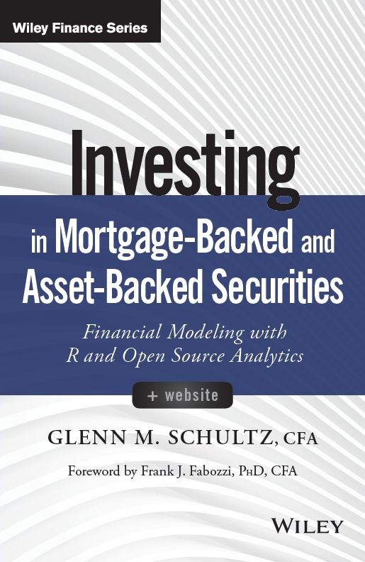
The R Package Bond Lab®
Bond Lab® is an R Package for the analysis of standard fixed-income (bonds) and Agency Mortgage Backed Securities (MBS)
Bond Lab adds to the following to the R finance eco-system
Mortgage prepayment and default models
Industry standard bond and MBS cash flow engines
Interest rate simulation model (Hull White)
Scale Implementation of the package Termstruc
(Bond Lab OTR Par Curve)
Will Bond Lab be offered on CRAN?, Yes! (our goal, a package that connects to our AWS UST and Agency MBS security database)

Slide 3
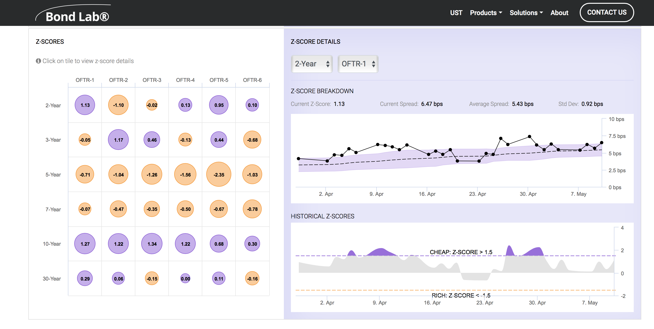
Bond Lab Technology Stack
Bond Lab Servers
Browser

Slide 4
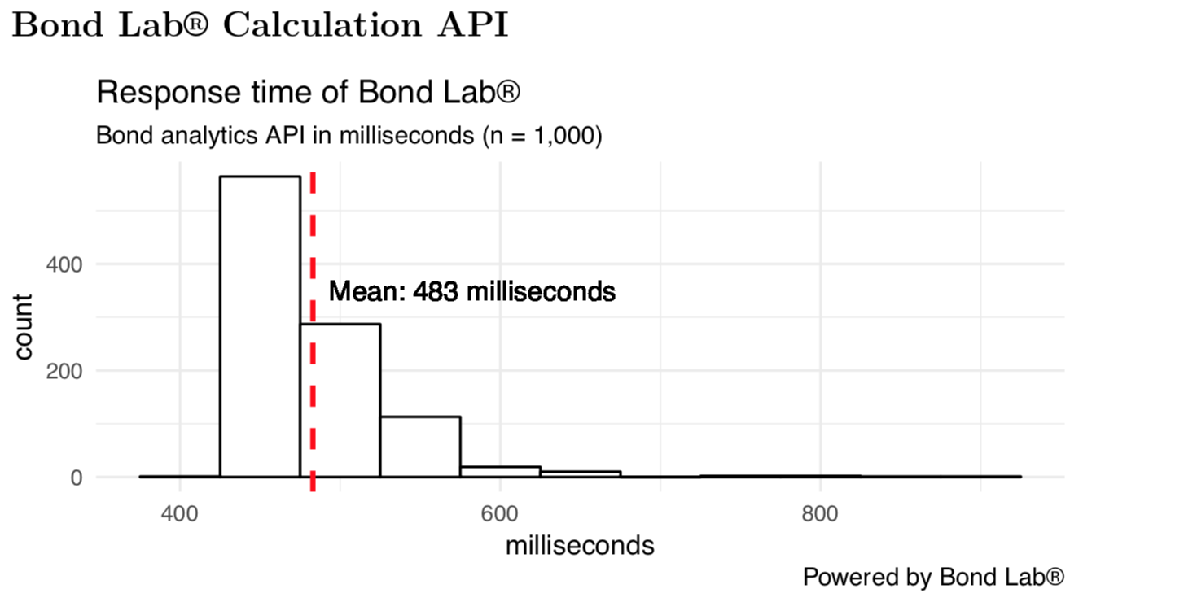
Bond Lab Calculation API
The API enables applications to integrate on-demand analytics from any web or mobile application.

Slide 5
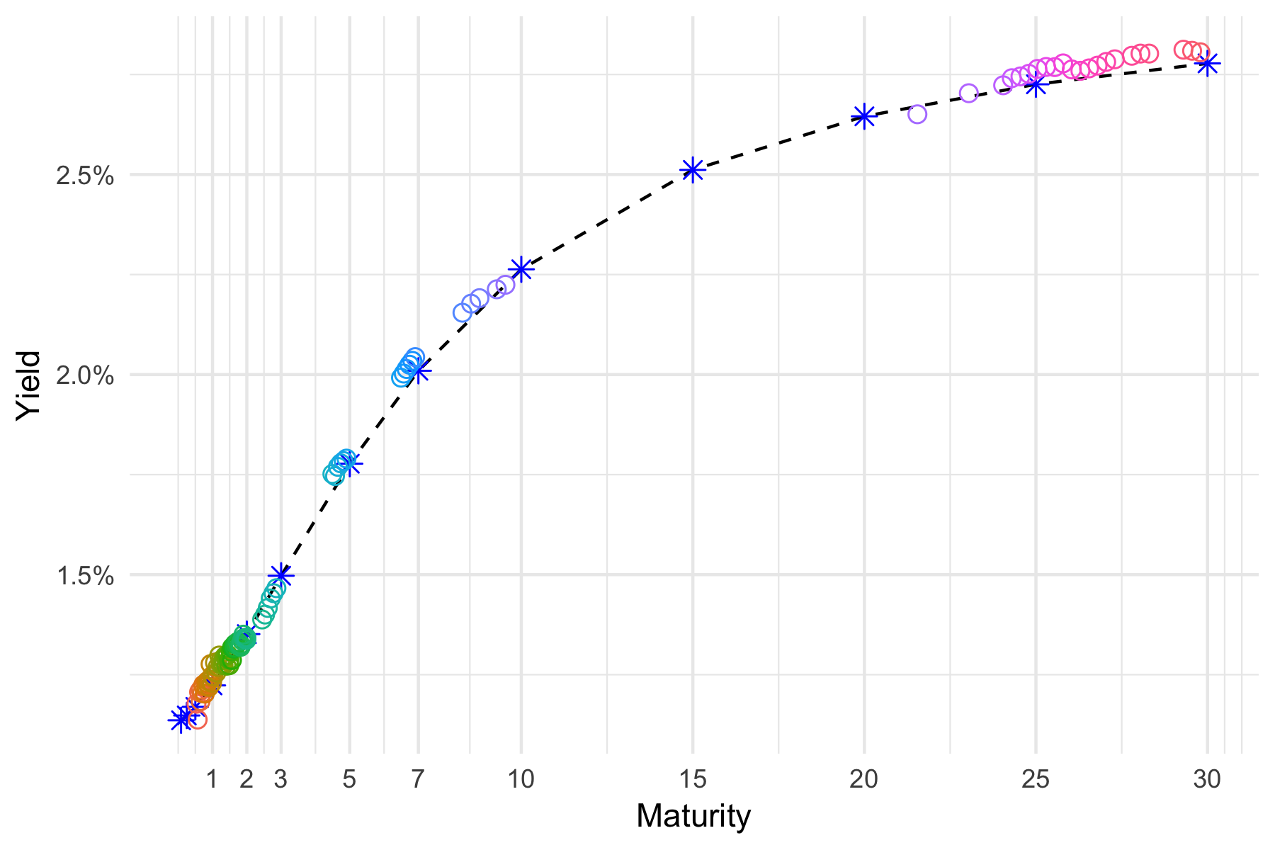
Bond Lab Data Package
The Bond Lab data package allows for ‘one liner’ access
to the security and stored analytics data bases. Here the Bond Lab data package is used to recall the Bond Lab par bond curve.

Slide 6
JSON Post to Bond Lab Libraries

Slide 7
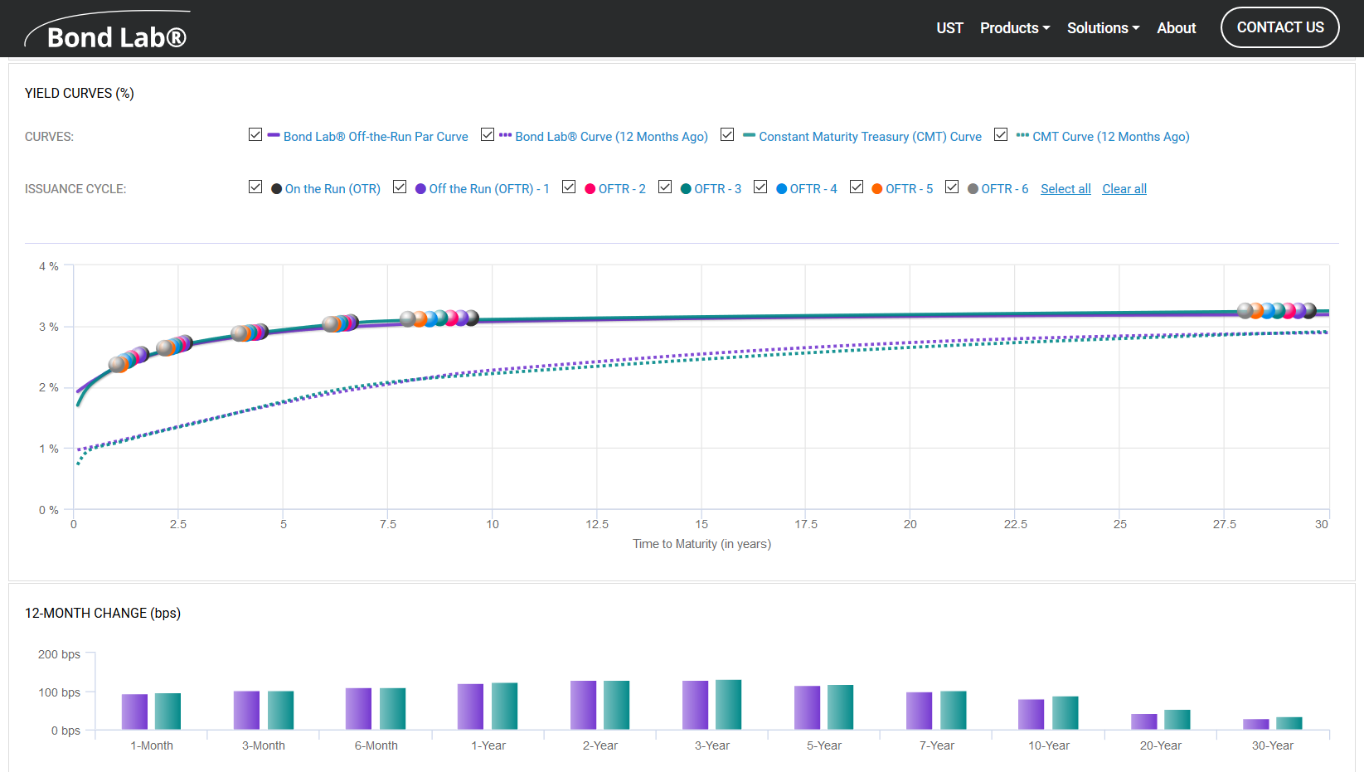
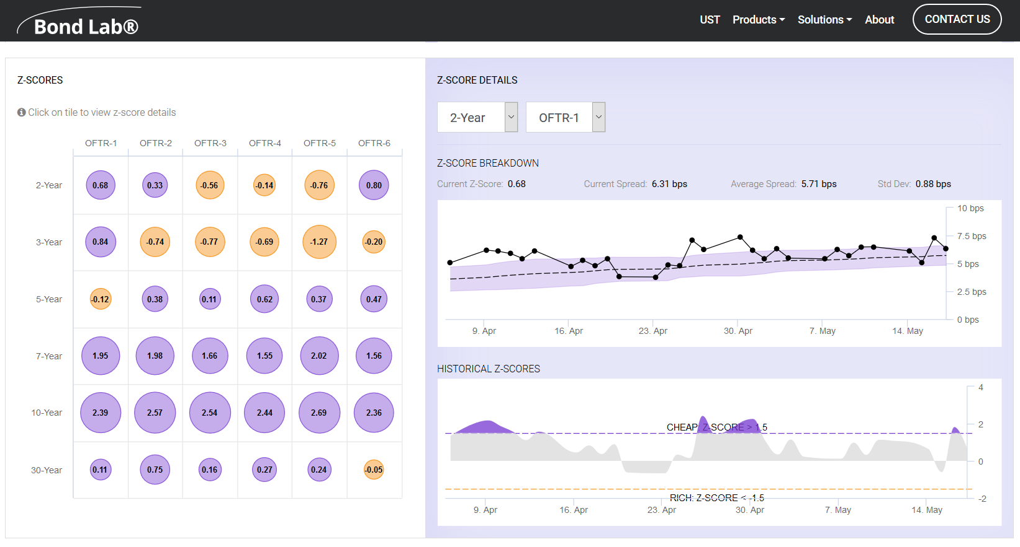
Bond Lab Website www.bondlab.io

