Slide 1
A Primer on Volatility Trading Strategies
By: Ilya Kipnis
https://quantstrattrader.wordpress.com

Slide 2
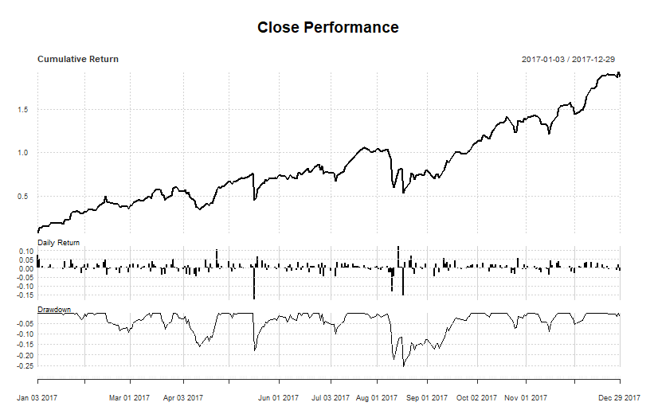
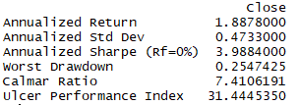
Why Trade Volatility?

Slide 3
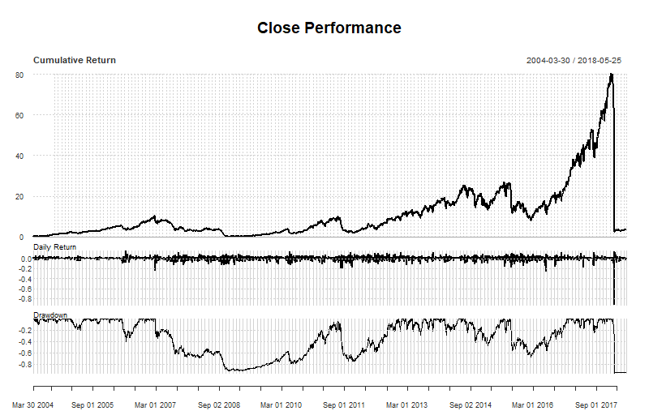
What’s The Catch?

Slide 4
Can We Do Better?
Want to avoid steep drawdowns
Sell vol in calm times
Buy vol in not-so-calm times
Stay on the sidelines in some cases.
Different strategies have different criteria for what constitutes calm or not.
Assumption: execute on next day’s close. Obs close + buy close: magicalThinking = TRUE

Slide 5
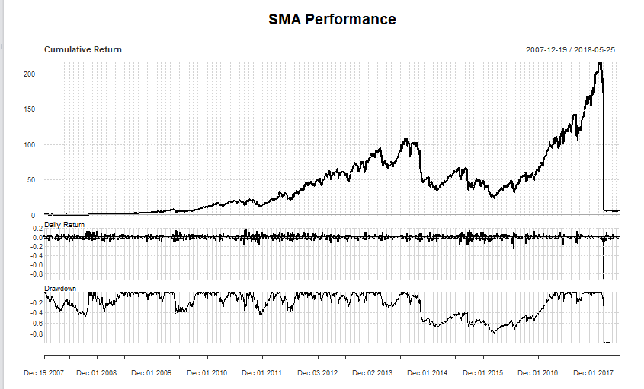
Easy Volatility Investing: V-Ratio
Go long vol (VXX) when SMA(VIX/VXV, 10) > 1, short vol (XIV/SVXY) otherwise.

Slide 6
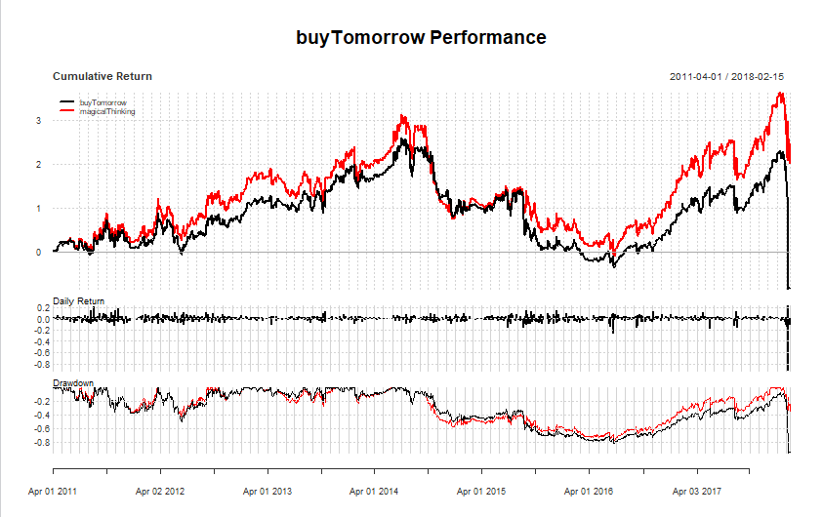
Easy Volatility Investing: Momentum Rotation
Switch between the highest 83-day momentum between XIV/SVXY, ZIV, VXZ, and VXX.

Slide 7
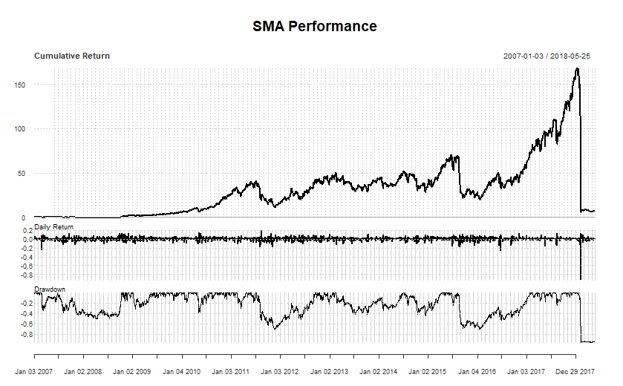
Easy Volatility Investing: Vol Risk Premium
Long XIV/SVXY when SMA(VIX – 10day SPY vol, 5) > 0, long VXX otherwise.

Slide 8
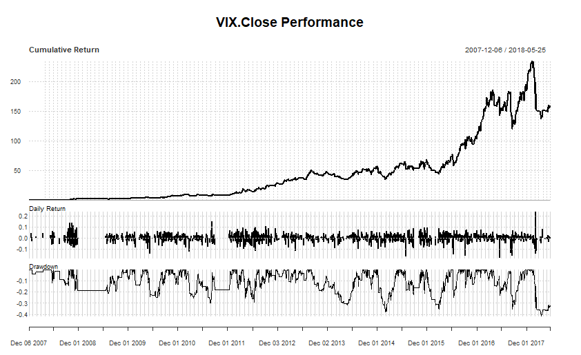
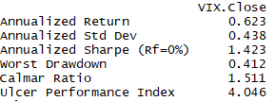
Easy Volatility Invest—ment Idea Rejections! Next?
Vance Harwood’s simple ratio: long XIV/SVXY when VIX/VXV < .917 (can be mirrored to long VXX when VIX/VXV > 1.083).

Slide 9
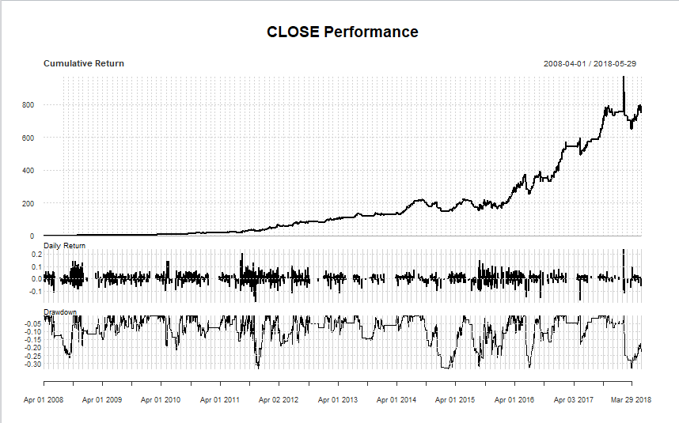
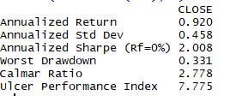
A Simple Prototype I Published In Late 2014
Compute ratio: VIX3M/VXMT (aka VIX6M)
XIV/SVXY when ratio < SMA(ratio, 60) & ratio < 1, VXX vice versa.

Slide 10
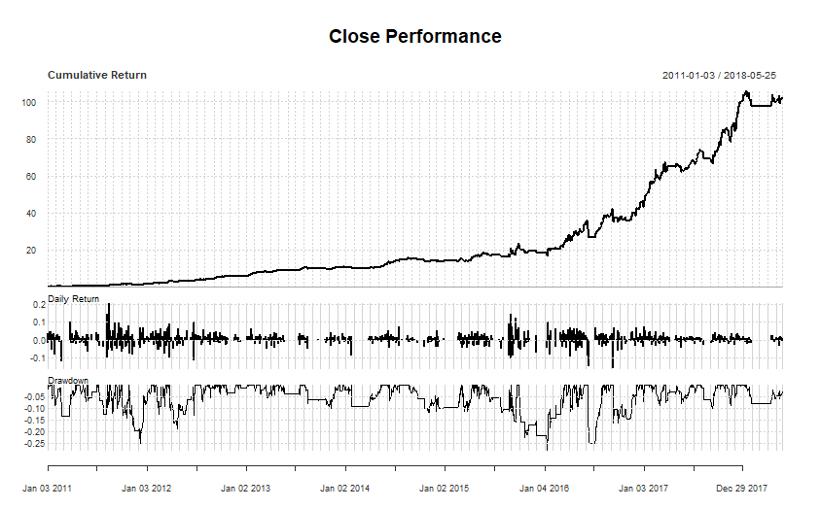
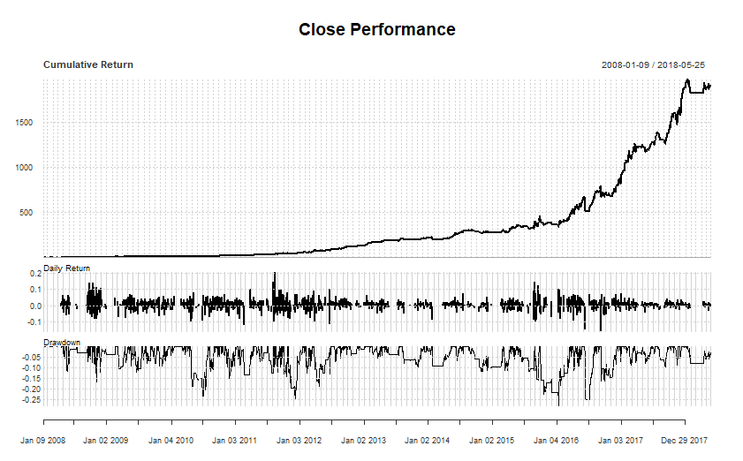
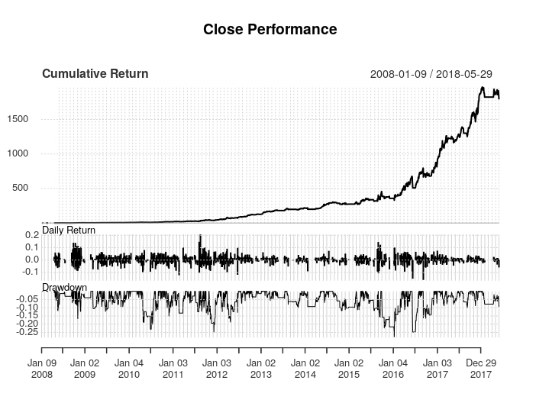
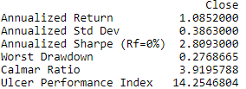
A Refined Prototype – Volatility Investing Can Be Done Well!
A strategy I currently trade (started trading late April 2017), latest iterations on short vol applied late 2017, latest iterations on long vol after Feb. 5

Slide 11
Volatility Trading Resources (Beyond My Blog)
Vance Harwood’s Six Figure Investing
https://sixfigureinvesting.com/
Invest In Vol (Volatility RIA)
https://investinvol.com
The CBOE has VIX futures data.
http://cfe.cboe.com/market-data/historical-data-archive
https://markets.cboe.com/us/futures/market_statistics/historical_data/

Slide 12
Thank You!
Contact: ilya.kipnis@gmail.comhttps://quantstrattrader.wordpress.com

